Slide 1
Self-Supervised 3D Reconstruction from Monocular Videos via Implicit Representation
Leonardo Bocchi
Supervisors: Meysam Madadi, Sergio Escalera
25 January 2024

Slide 2
Introduction

Slide 3
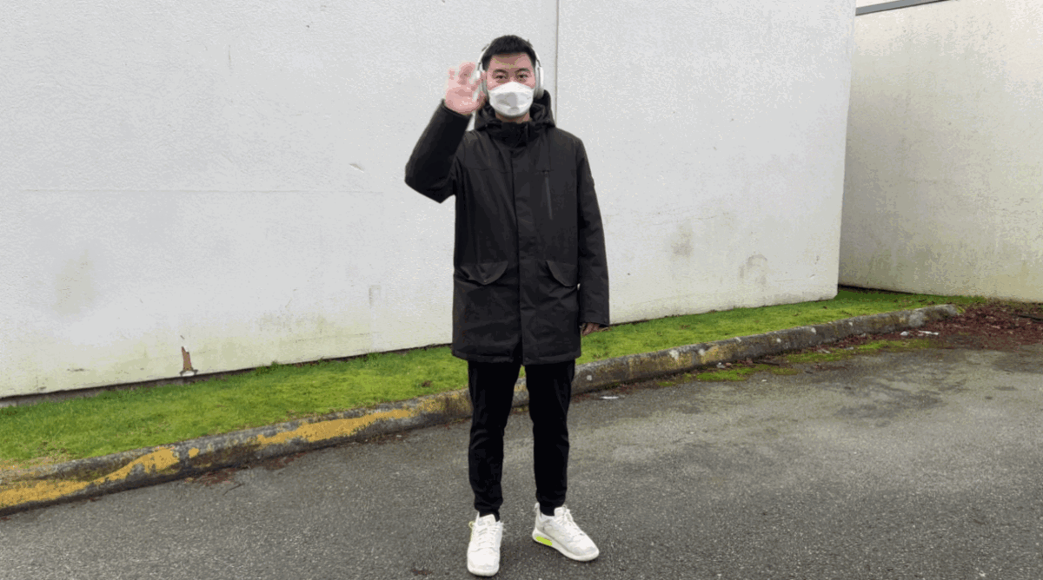
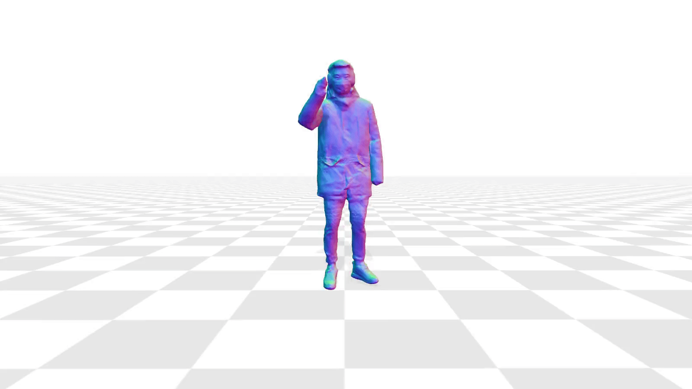
Problem definition
3D avatar reconstruction: the 3D reconstruction of a clothed human subject from a 2D video

Slide 4
Motivations
Virtual environments
Virtual try-on
Cost Speed Expertise
Human-machine interaction
Content creation and personalization

Slide 5
Background
3D rendering: 2-D images from a 3-D scenes. It involves modeling, texturing, lighting, and shading
3D reconstruction: 3-D representation from 2-D images. It involves the extraction of spatial data and the generation of a 3D model

Slide 6
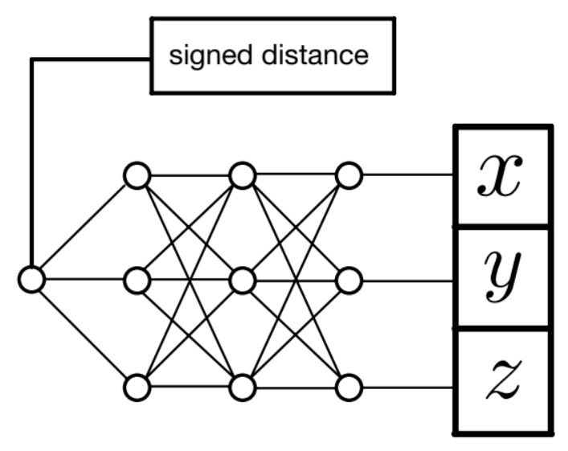
3D reconstruction: neural implicit representation
3D rendering: ray casting
positive sdf values
negative sdf values
3D sampled points
Implicit neural network
2D
3D

Slide 7
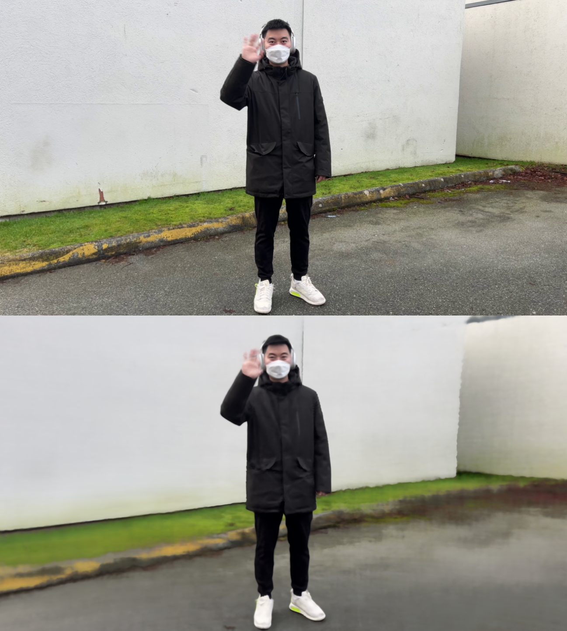
Dataset & Evaluation
Neumann
3DPW
Evaluation of the results is performed on the Neumann and 3DPW dataset
Quantitative metrics: rendering metrics
PSNR: Peak Signal-to-Noise Ratio
SSIM: Structural Similarity Index Measure
Original image
Rendered image

Slide 8
Video Reconstruction Module

Slide 9
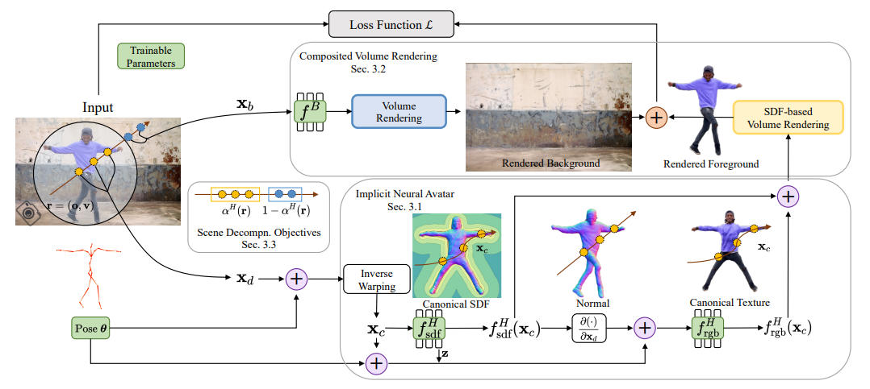
Video Reconstruction Module Baseline
Point sampling
Points outside the initial bounding sphere are sampled coarsely
Points inside the initial bounding sphere are sampled densly
Pose parameters
Figure from [1]

Slide 10
Video Reconstruction Module Baseline
The pose parameters are used to project sampled points to the canonical space
The implicit network outputs corresponding signed distances
The rendering network outputs corresponding rgb values
implicit network
rendering network
Projection to canonical space
Figure from [1]

Slide 11
Video Reconstruction Module Baseline
Composite volume rendering
Radiance network
Figure from [1]

Slide 12
Self-Supervised Optimization
The training of the model is performed by optimizing a composition of 4 different loss functions
where, and represent the sets of optimized parameters for the human and background models
.
.

Slide 13
Global optimization objectives
Reconstruction loss
Enforces similarity between rendered image and actual rgb frame
Eikonal loss
Enforces the implicit network to satisfy the Eikonal equation in canonical space

Slide 14
Scene decomposition objectives
Opacity sparseness regularization
Self-supervised ray classification

Slide 15
Experimental Results

Slide 16
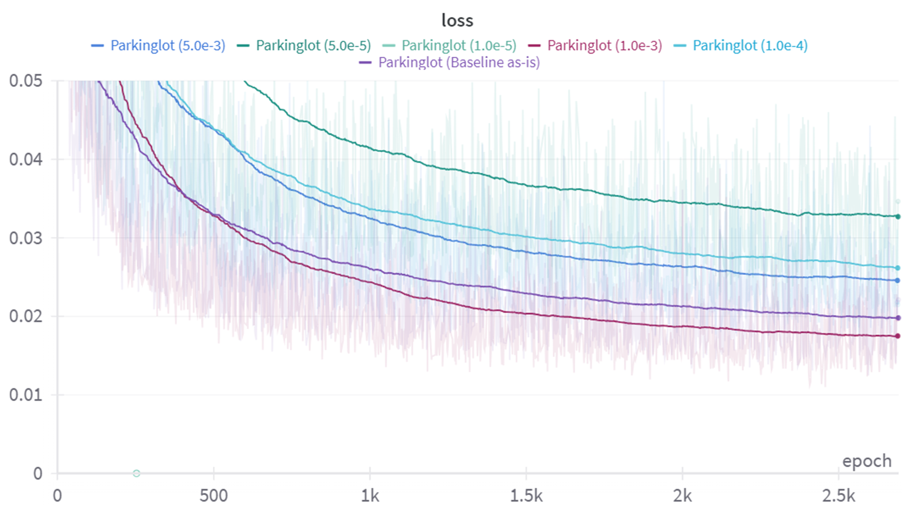
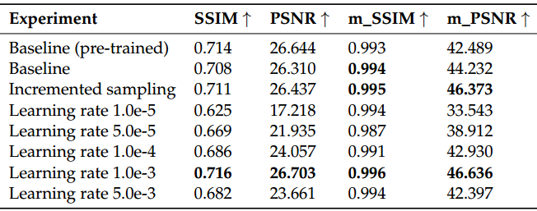
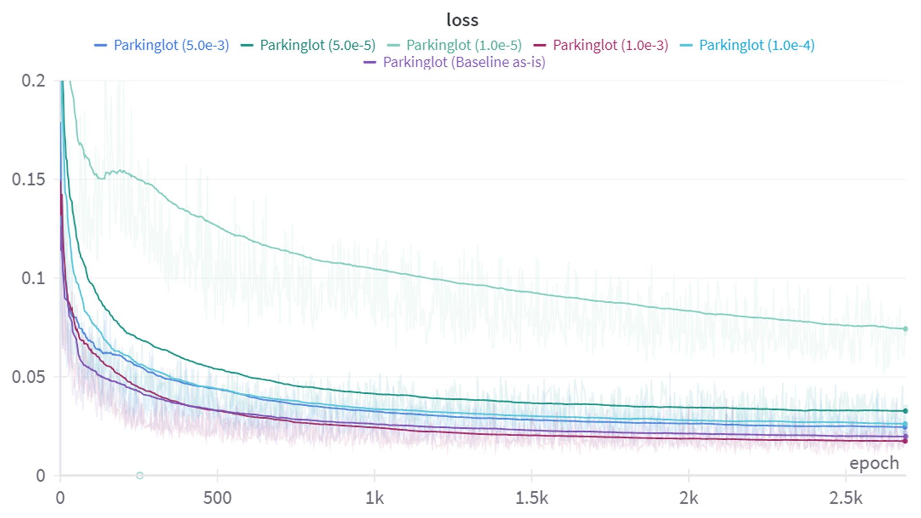
Hyperparameters tuning
5.0e-5
1.0e-4
5.0e-3
baseline
1.0e-3
A larger number of sampling improves the reconstruction
Higher learning rates yield slightly better optimization overall

Slide 17
Time consistency
Displacement of canonical points through frames
Increase in time per training step
Not a significant or conclusive improvement
Similarity of the signed distance field through frames

Slide 18
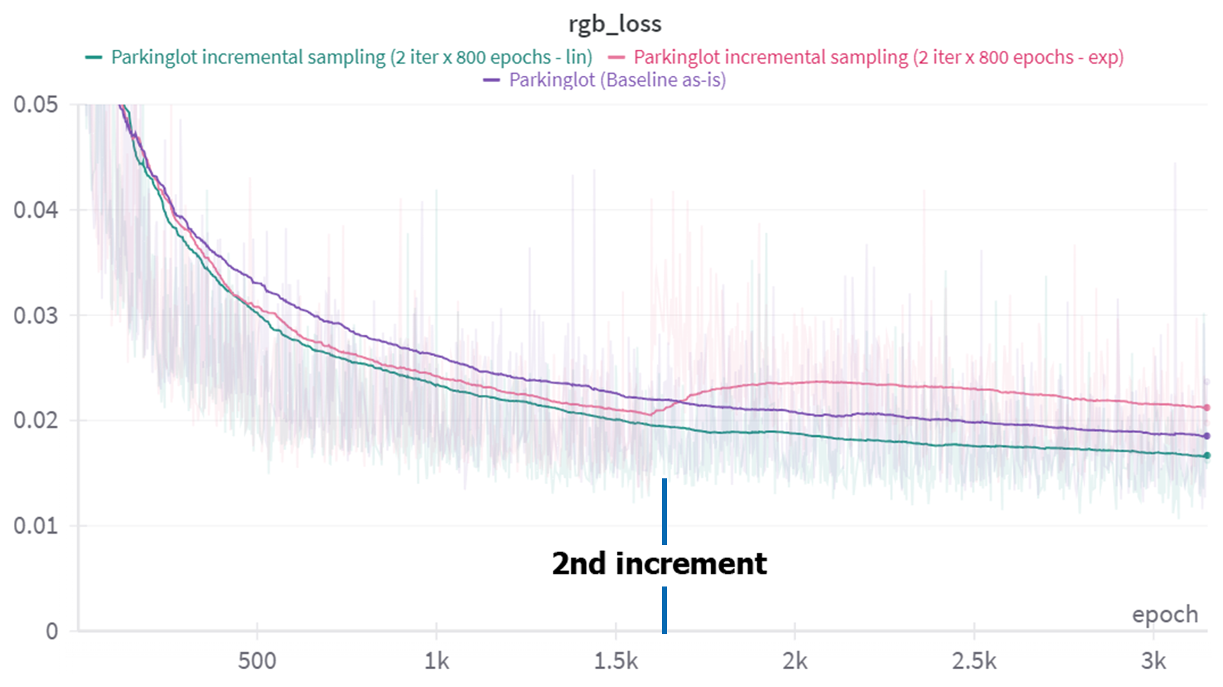
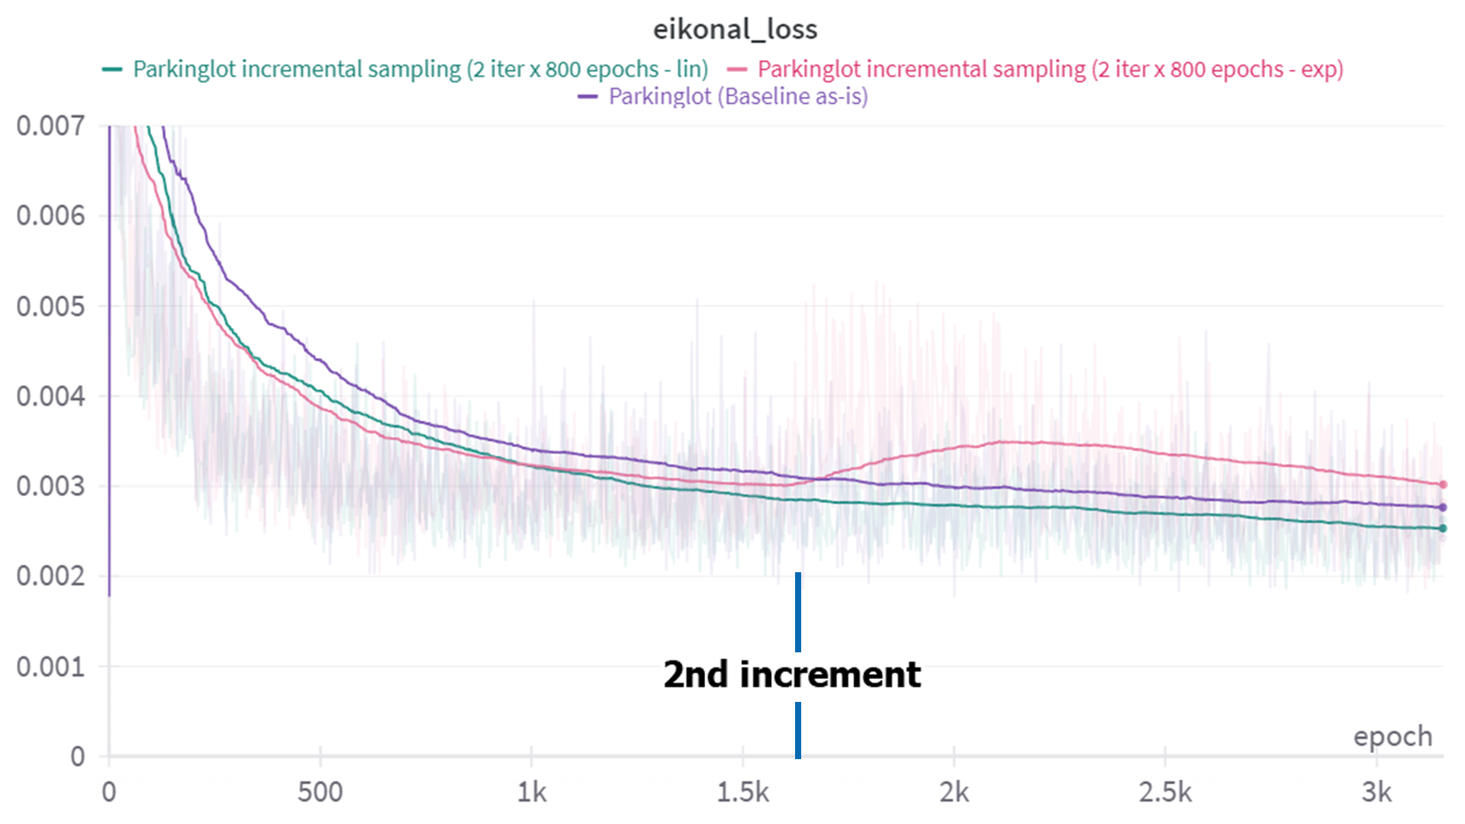
Incremental sampling

Slide 19
AGen Model

Slide 20
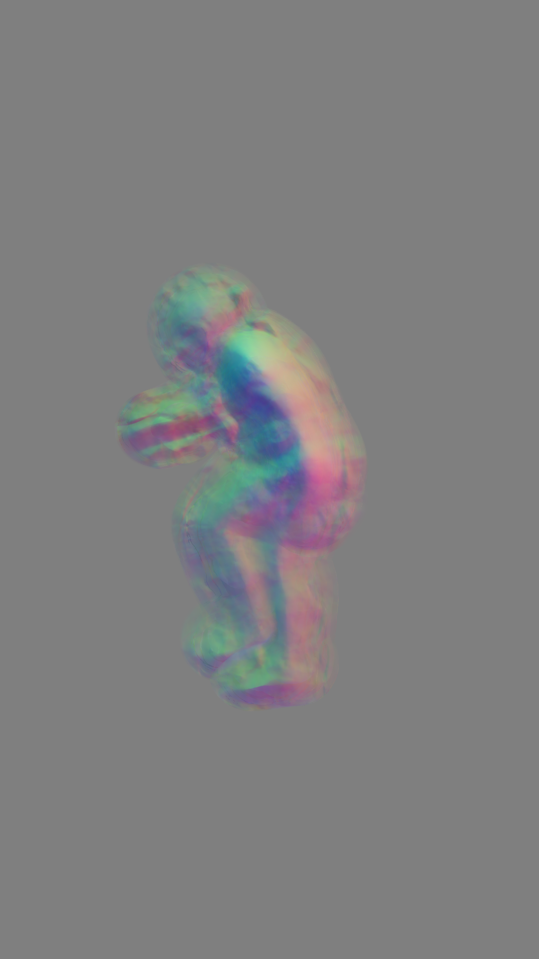
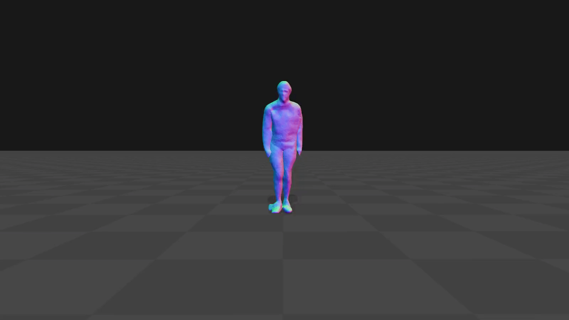
Scope of the project
Given as input a series of frames from a monocular video, the model shall be able to yield
Inference-time 3D avatar reconstruction
Short-time optimized 3D avatar reconstruction
pretrained implicit representation
refinement

Slide 21
AGen model pipeline
*The video specific training is resumed for video specific networks (background) and further trained generalized networks (foreground)
Video 1*
Train set
Video 1
Video reconstruction module
Video 2*
Video specific reconstruction training
Video 3*
AGen model
Implicit network
Geometry encoding network
Rendering network
Inference after training
Outputs
Canonical representation
Deformed representation
Rendering
Possibility of complete reconstruction with faster times (fitting w/ pretrained general models)
Test set (inference time)

Slide 22
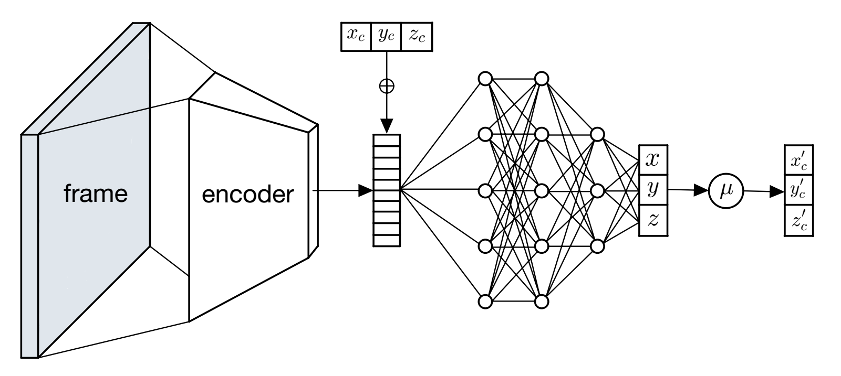
Geometry encoding network
Objective: improve the generalization of the model and quality of reconstruction
Garment details and texture
Frame-conditioned 3D displacements

Slide 23
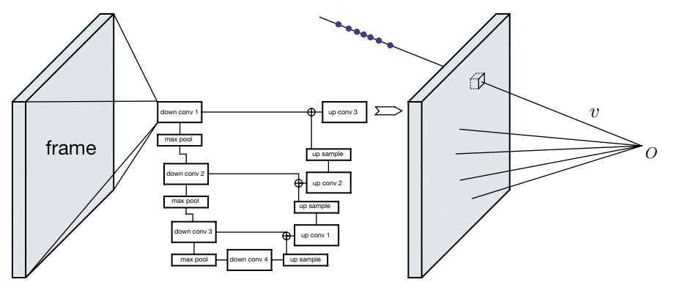
Geometry encoding network
Unet encoder
Unet encoder: yields a pixel-aligned embedding
Geometry morphing loss:

Slide 24
Experimental Results

Slide 25
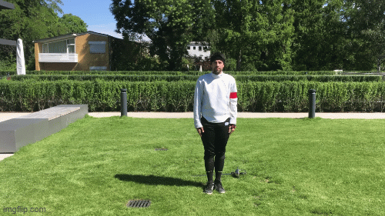
Baseline vs non-pretrained reconstruction
Original
Non-pretrained Reconstruction
AGen Baseline

Slide 26
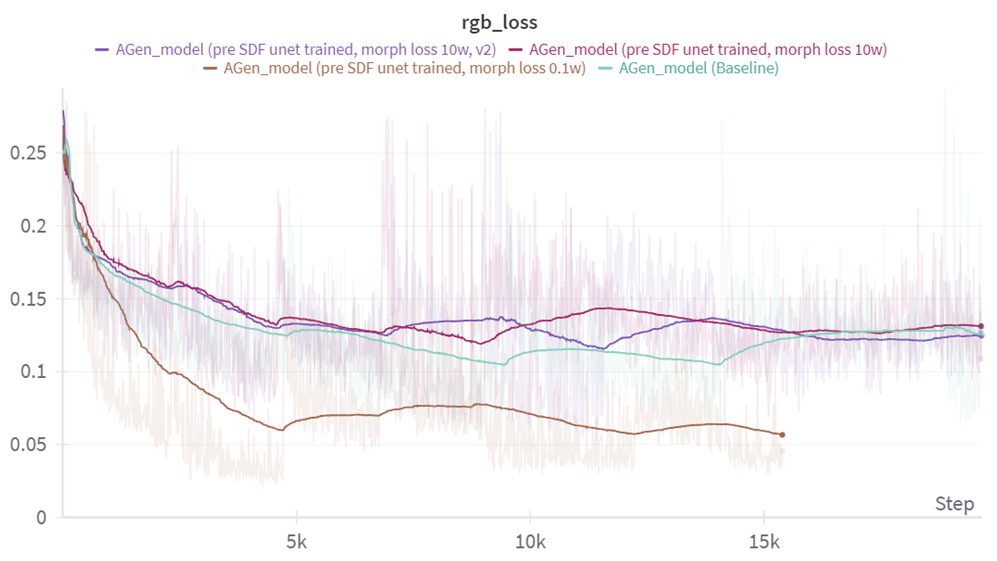
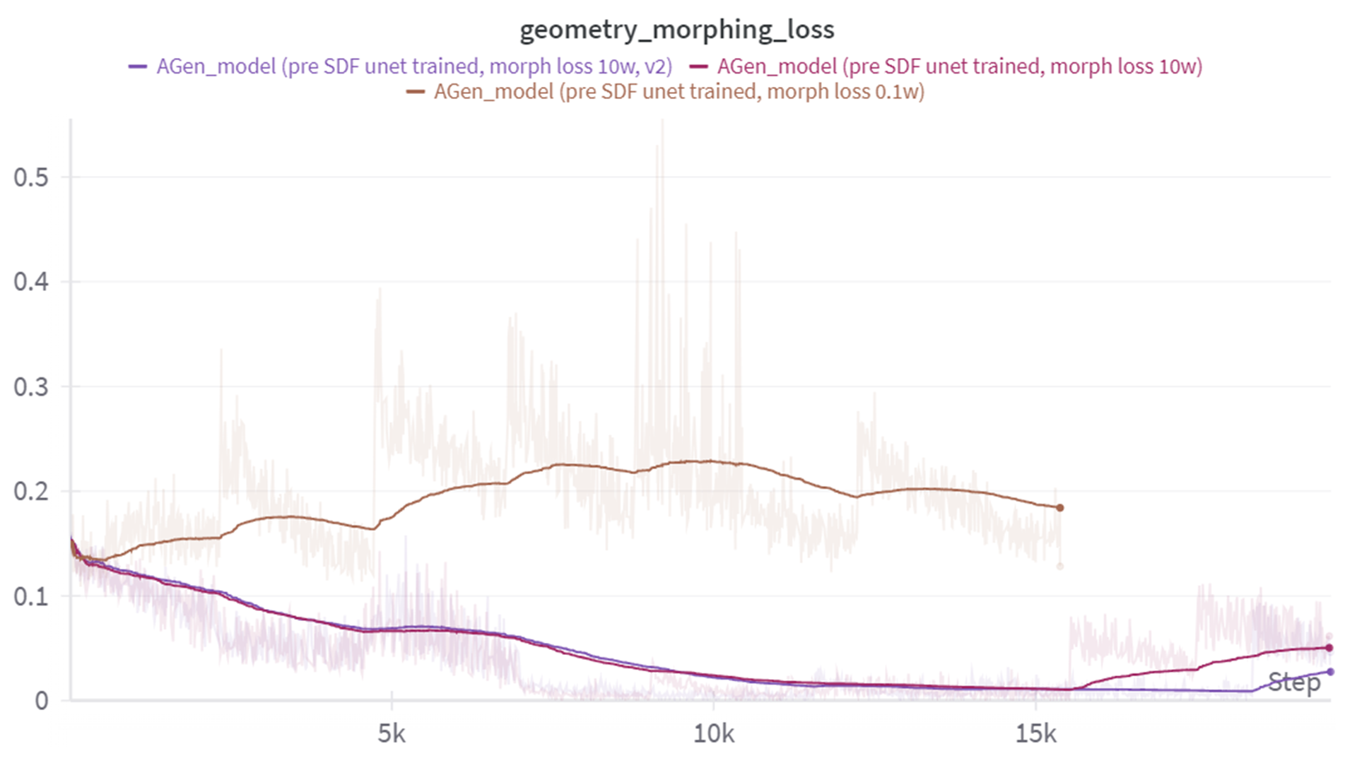
Geometry encoding network
Unconstrained geometry encoding network
Steep reduction of the rgb loss

Slide 27
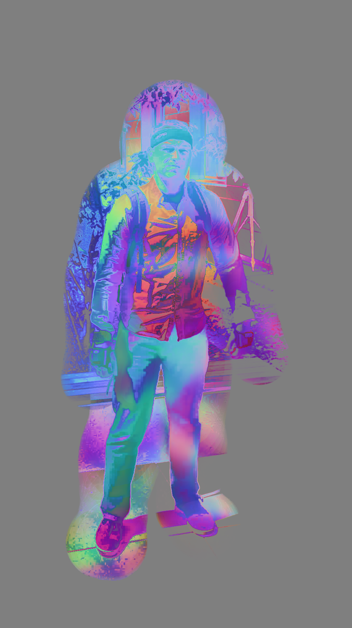
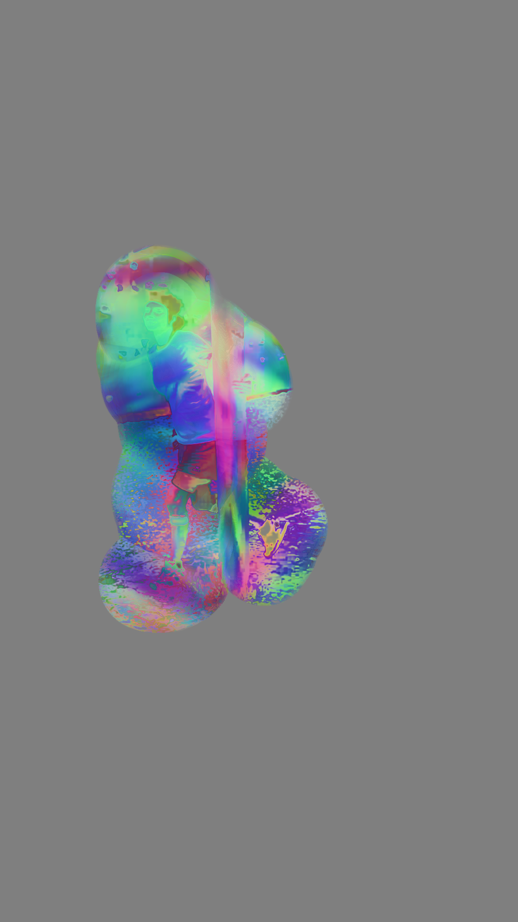
Geometry encoding network: ablation study
Geometry morphing loss: leaving the displacements unconstrained causes the network to project the points to a plane parallel to the image frame to better optimize the other losses
FIGURE: Collateral cases with unconstrained geometry encoding network

Slide 28
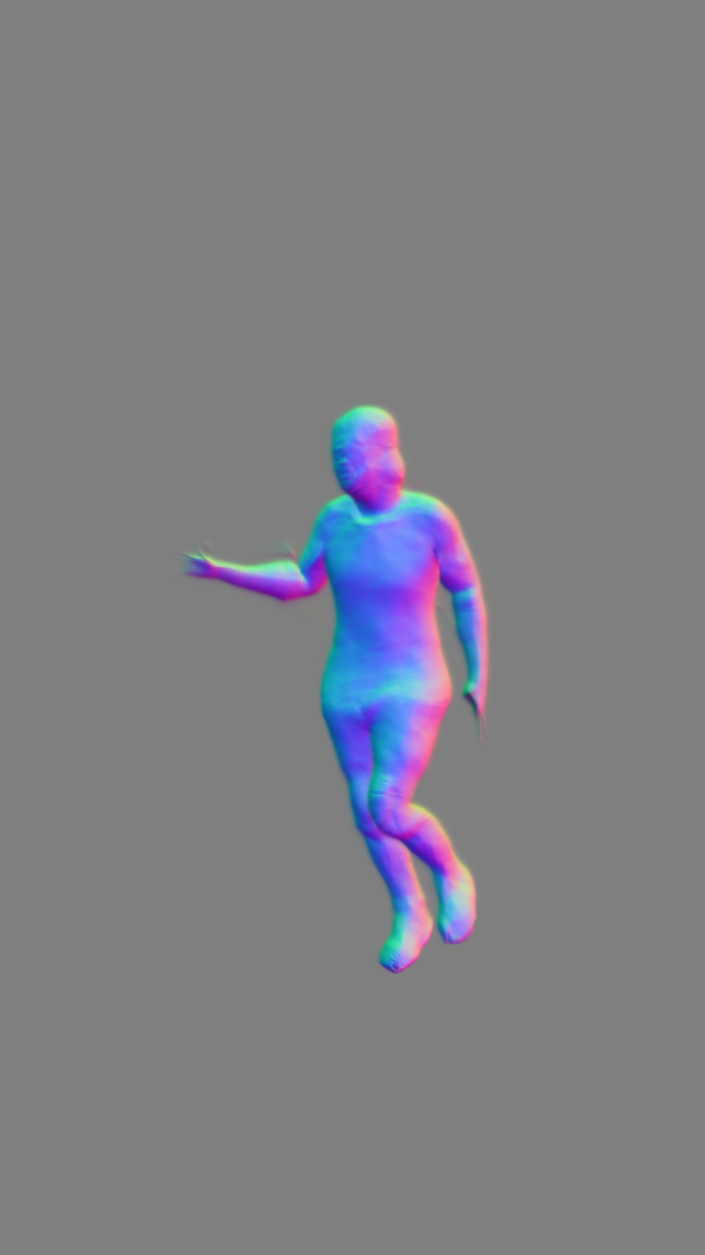
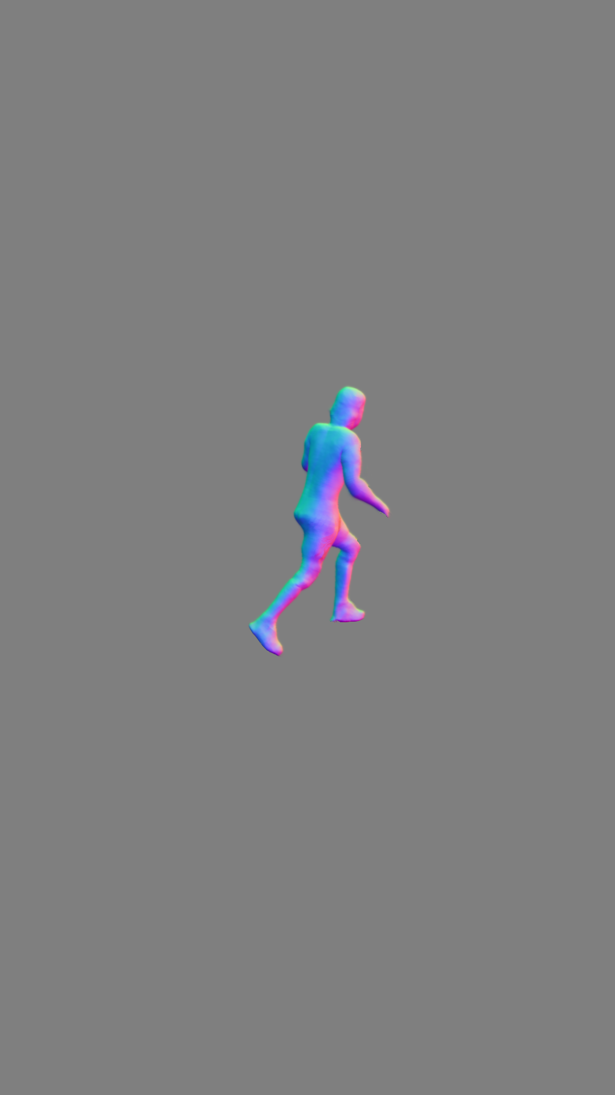
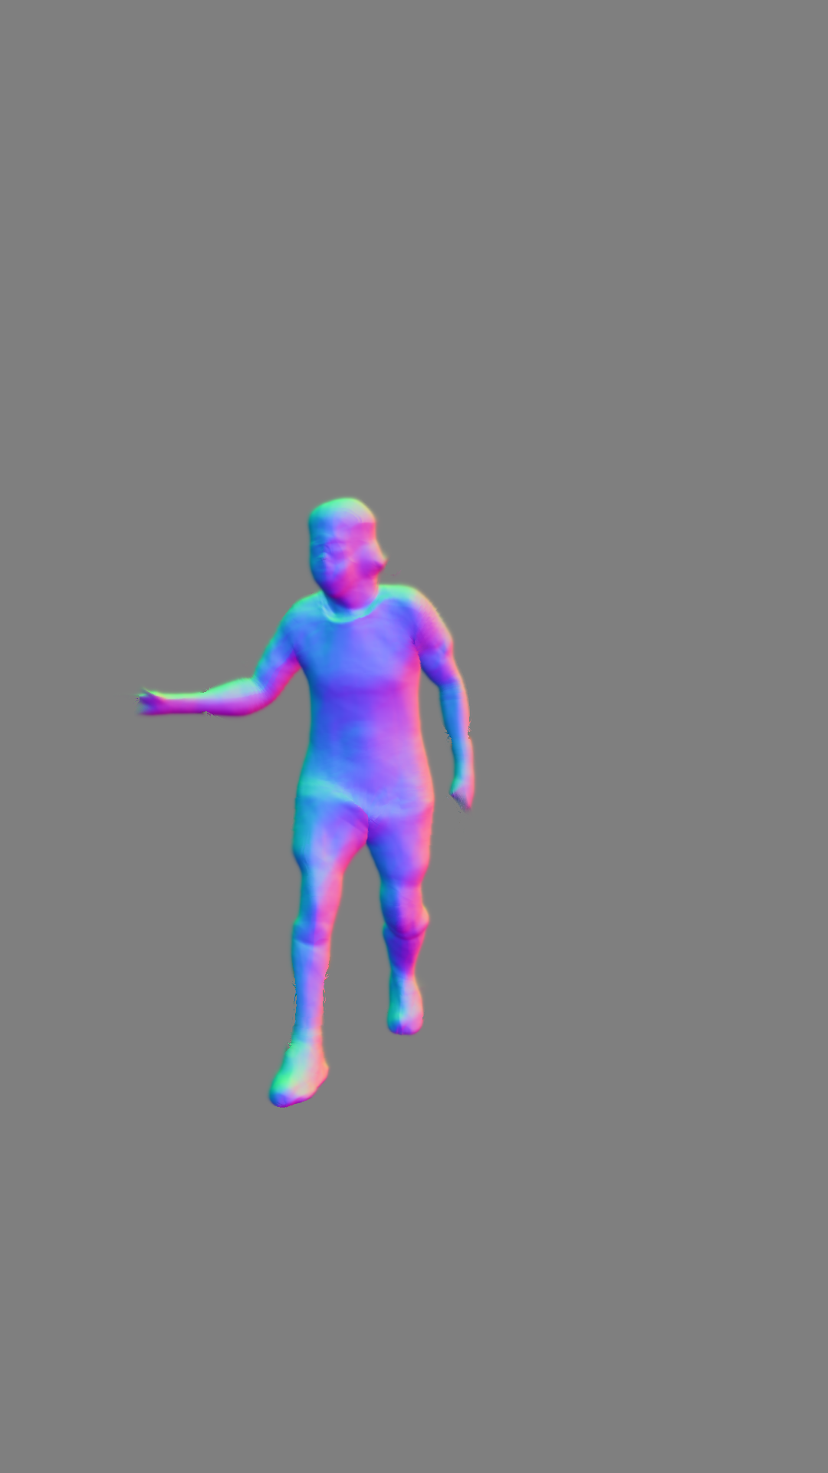
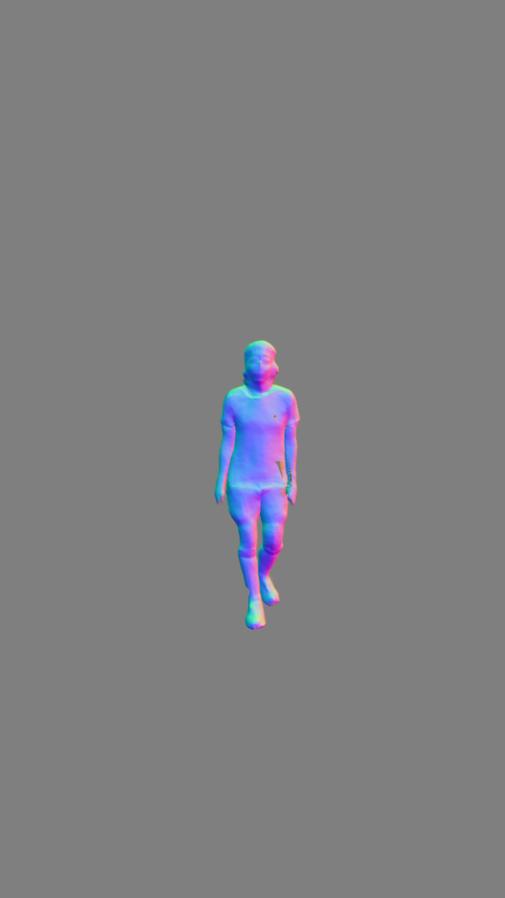
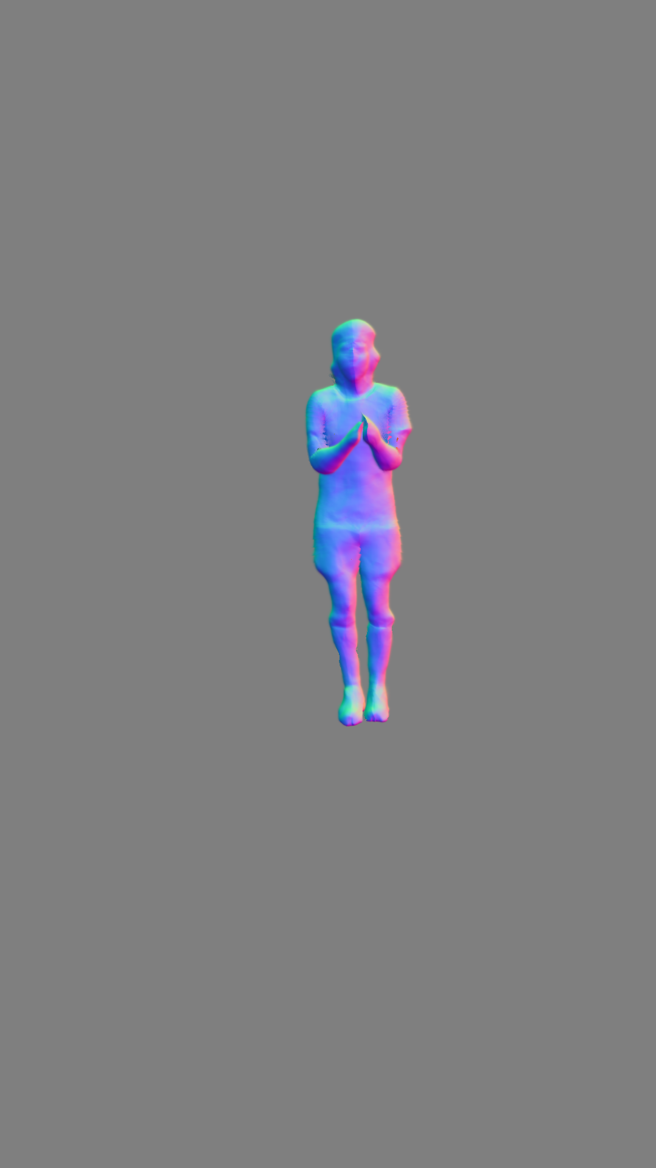
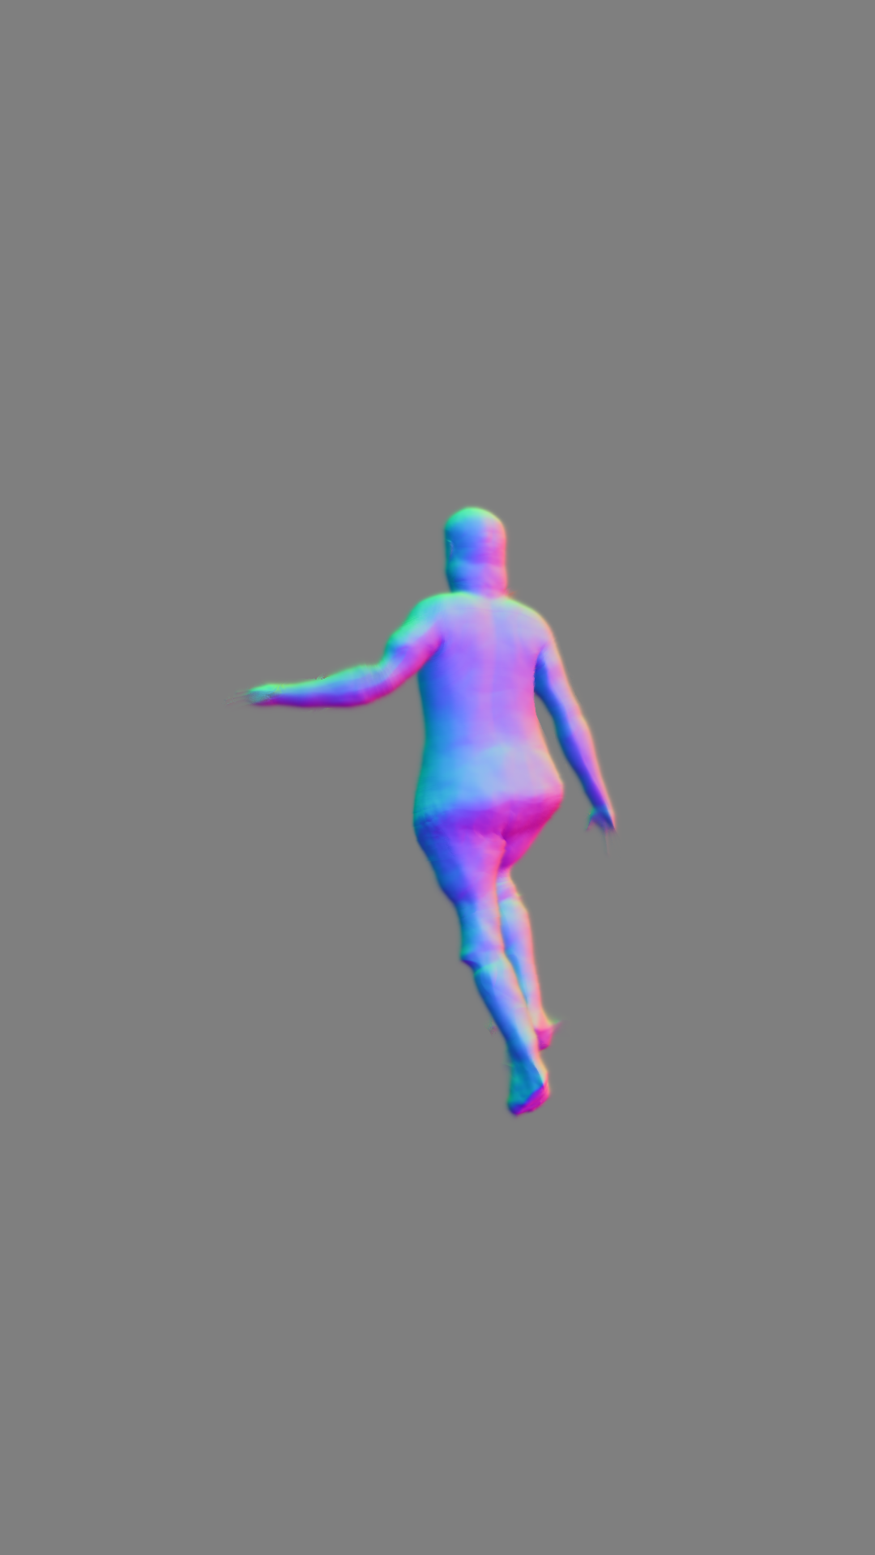
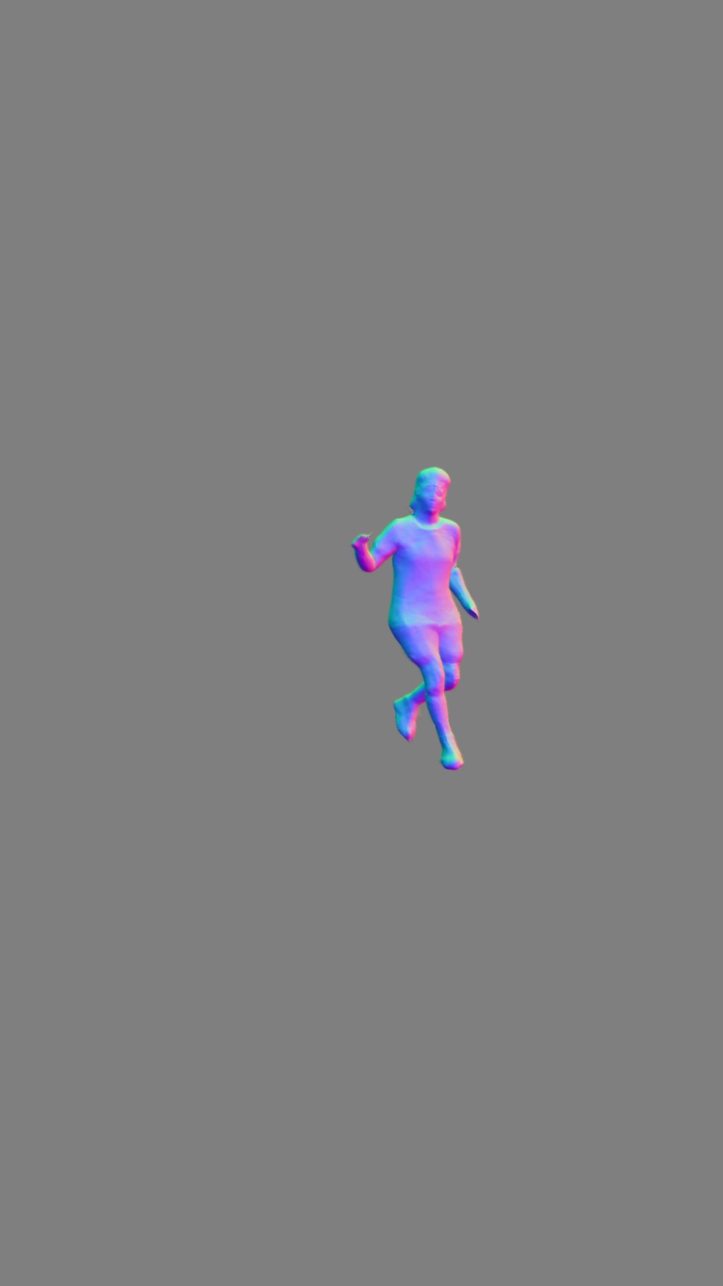
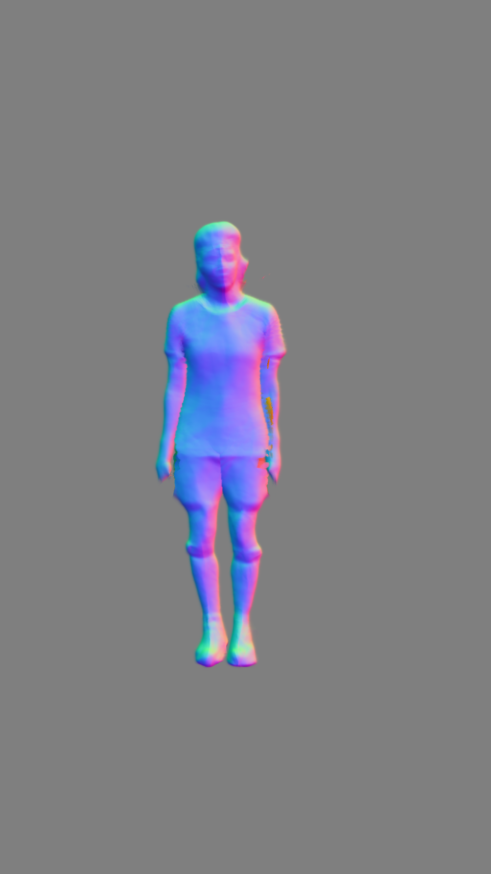
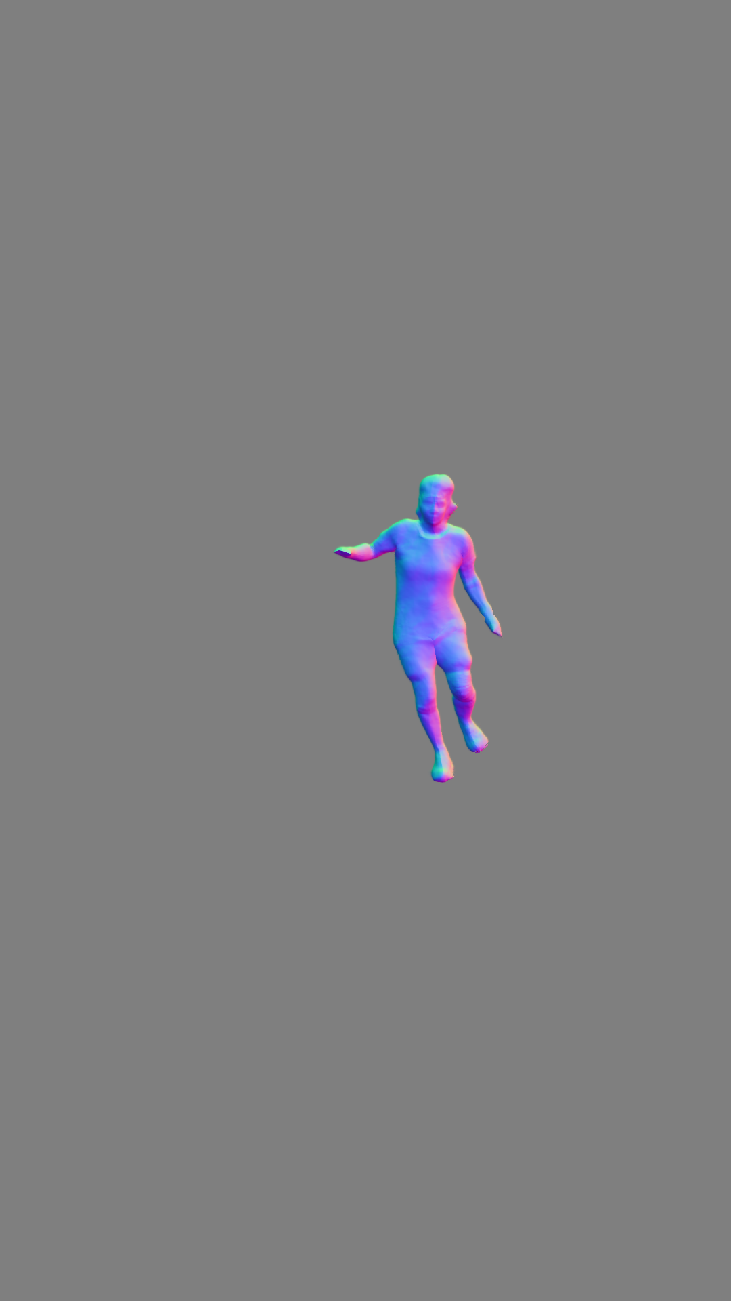
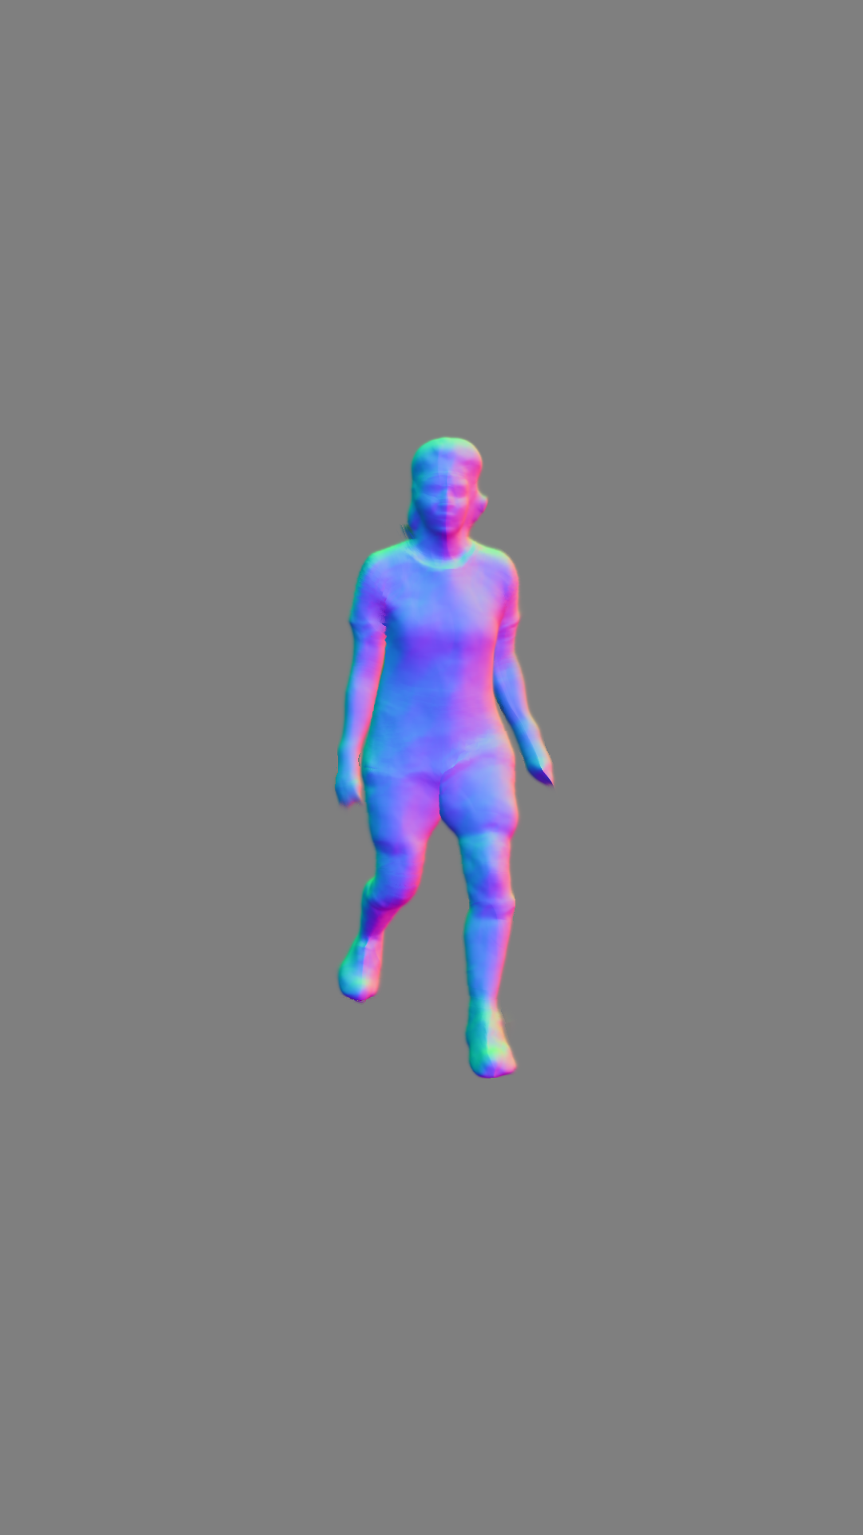
Some qualitative results
Outdoors slalom 00
13
27
41
54
68
n° epochs
Outdoors slalom 01
11
23
36
48
59
n° epochs

Slide 29
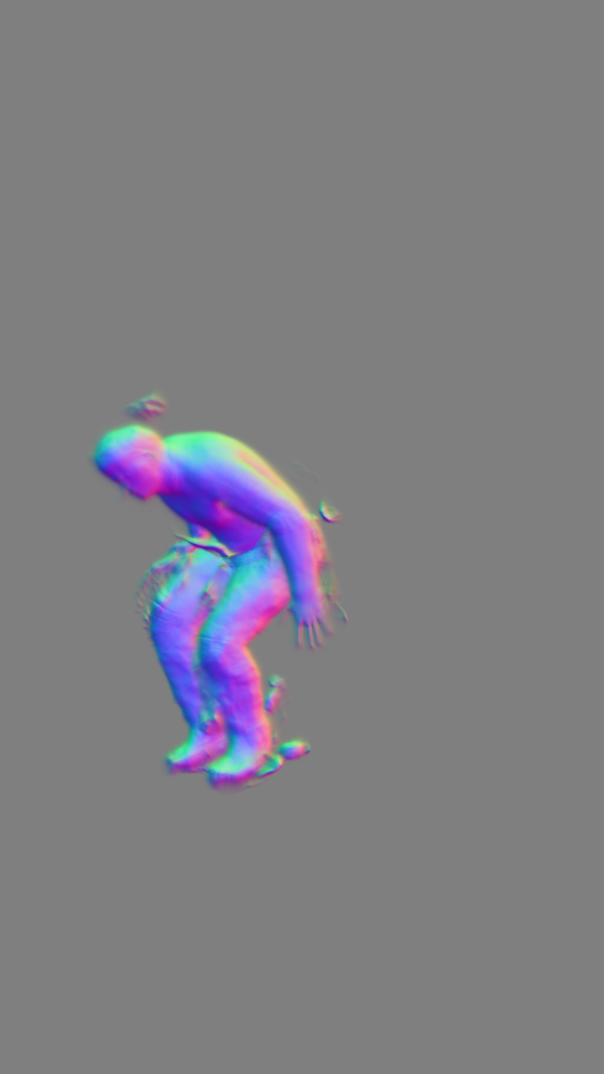
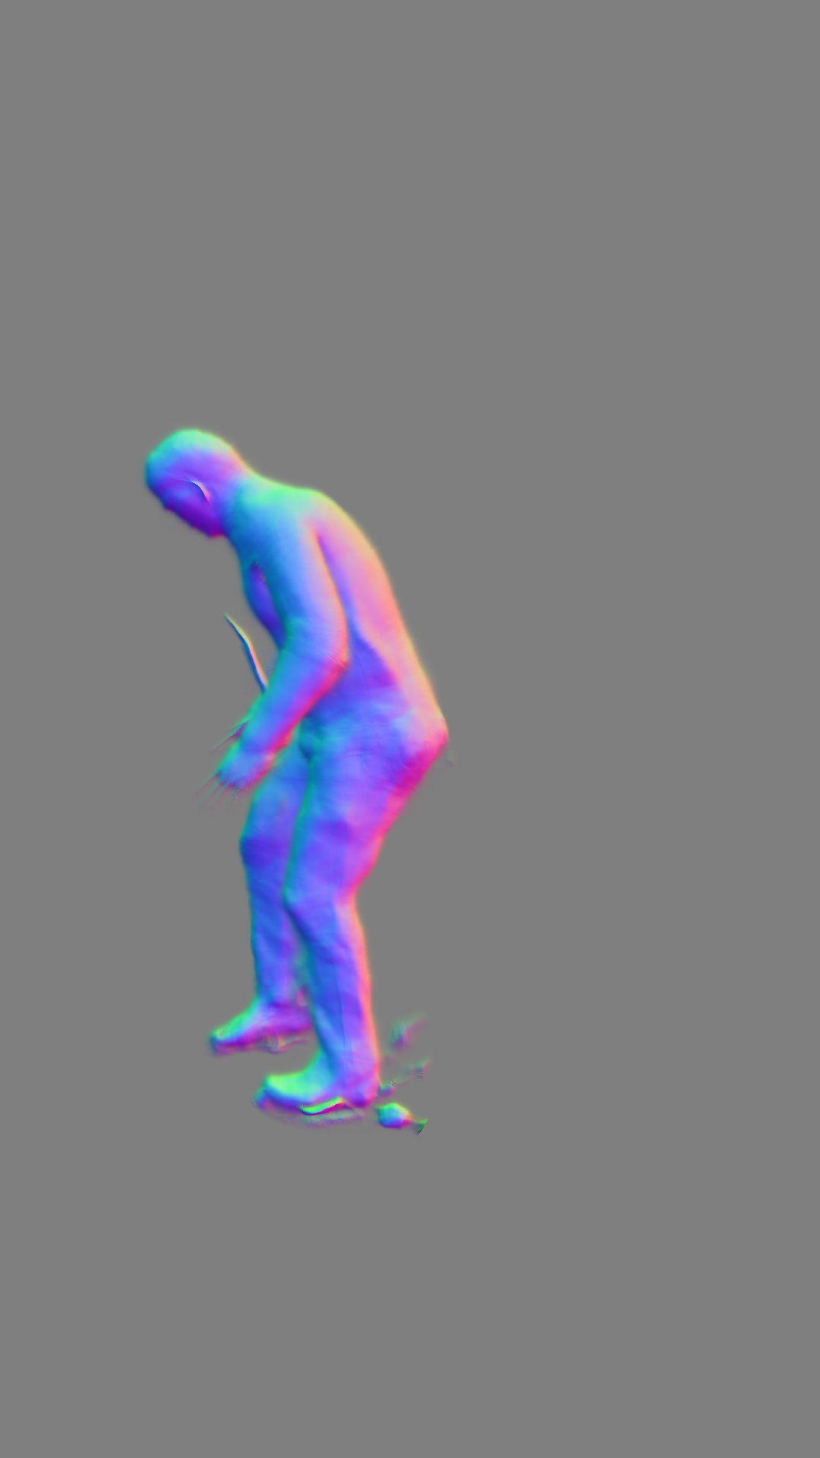
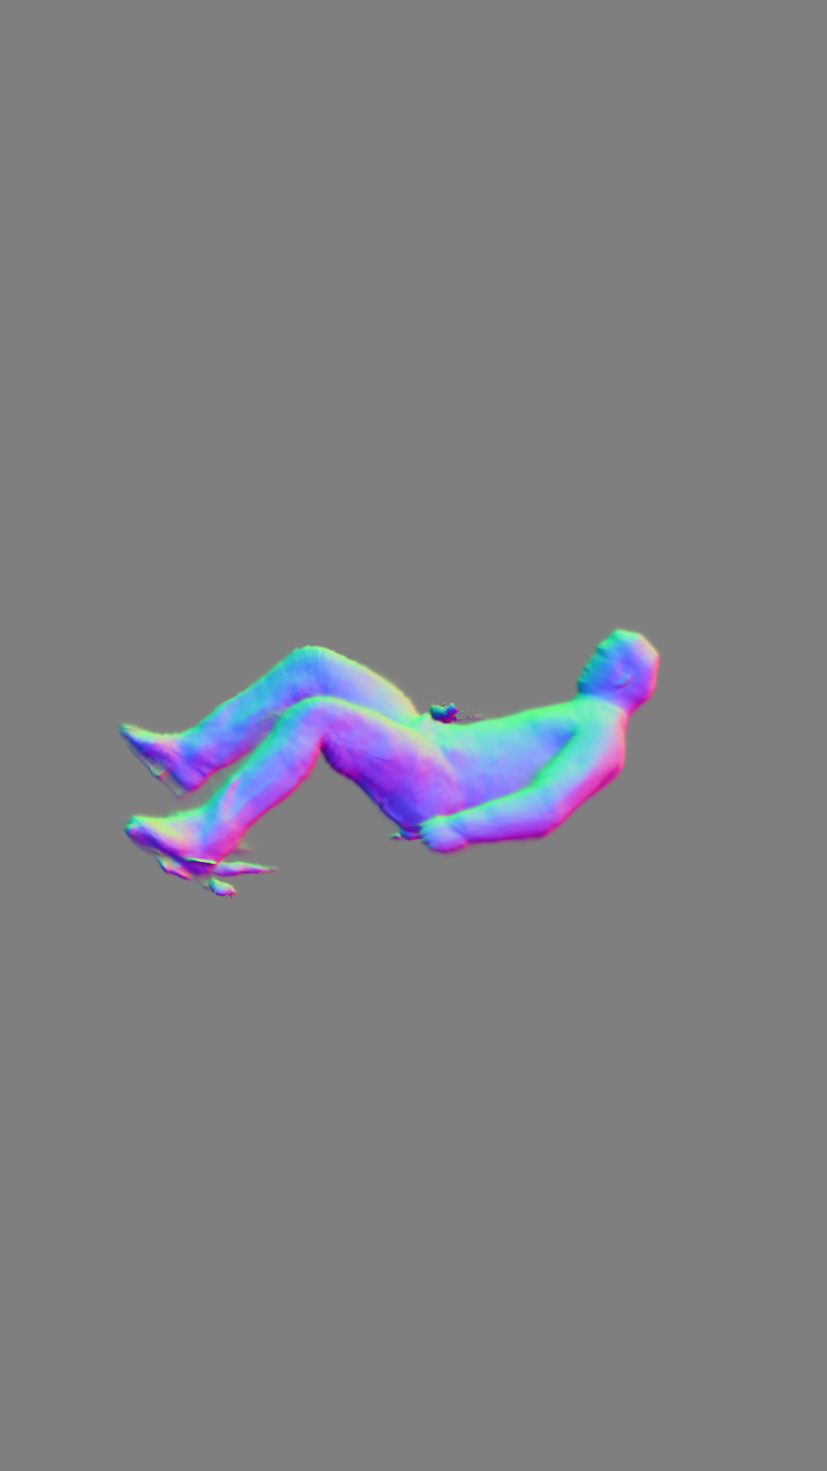
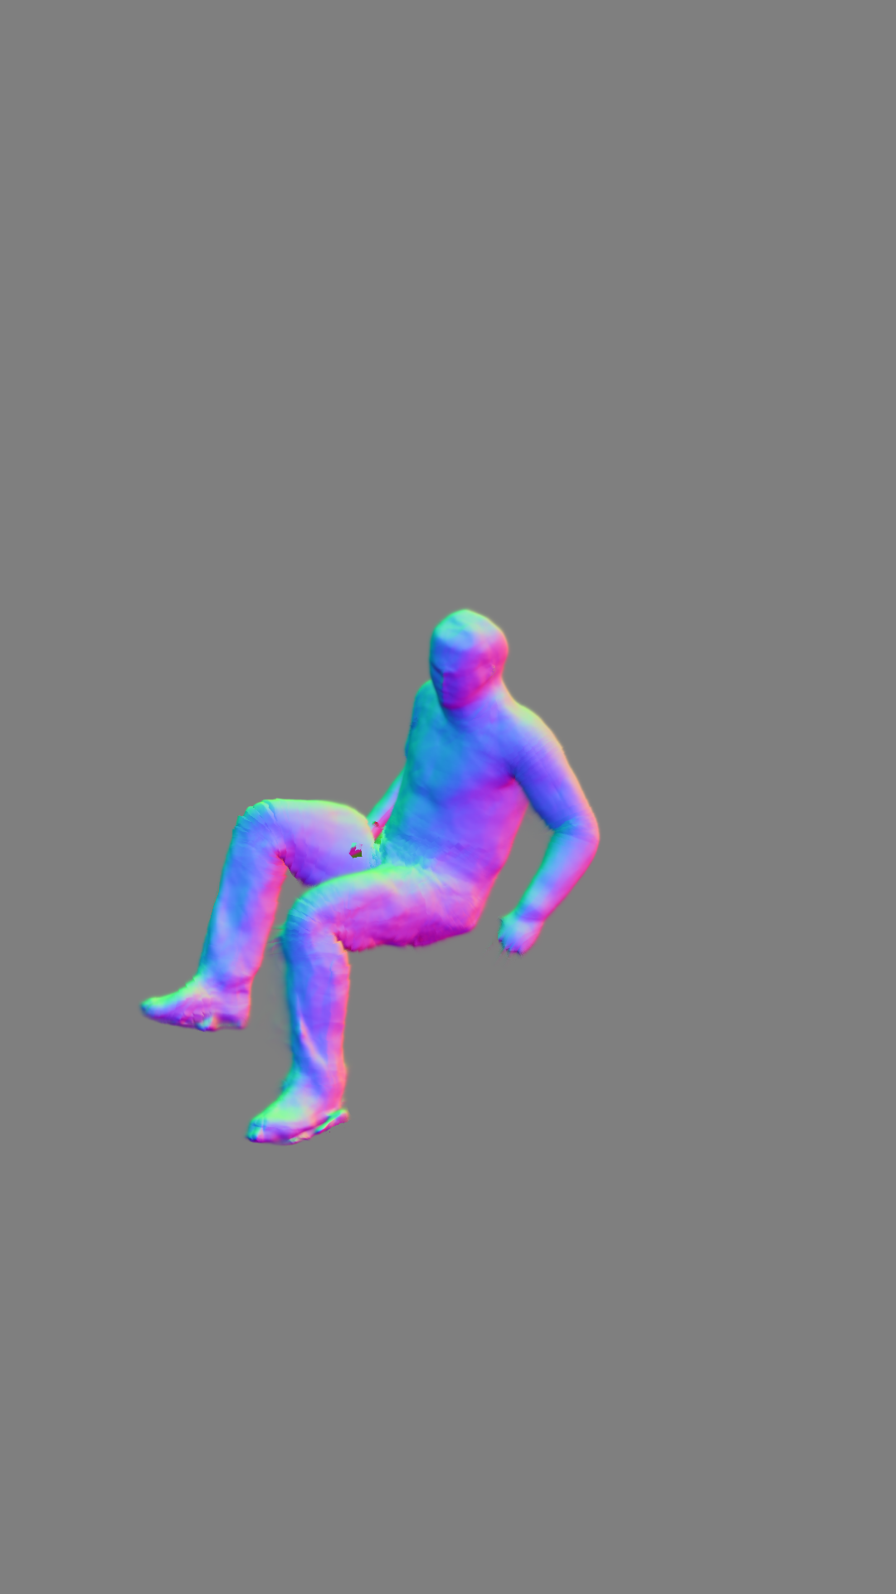
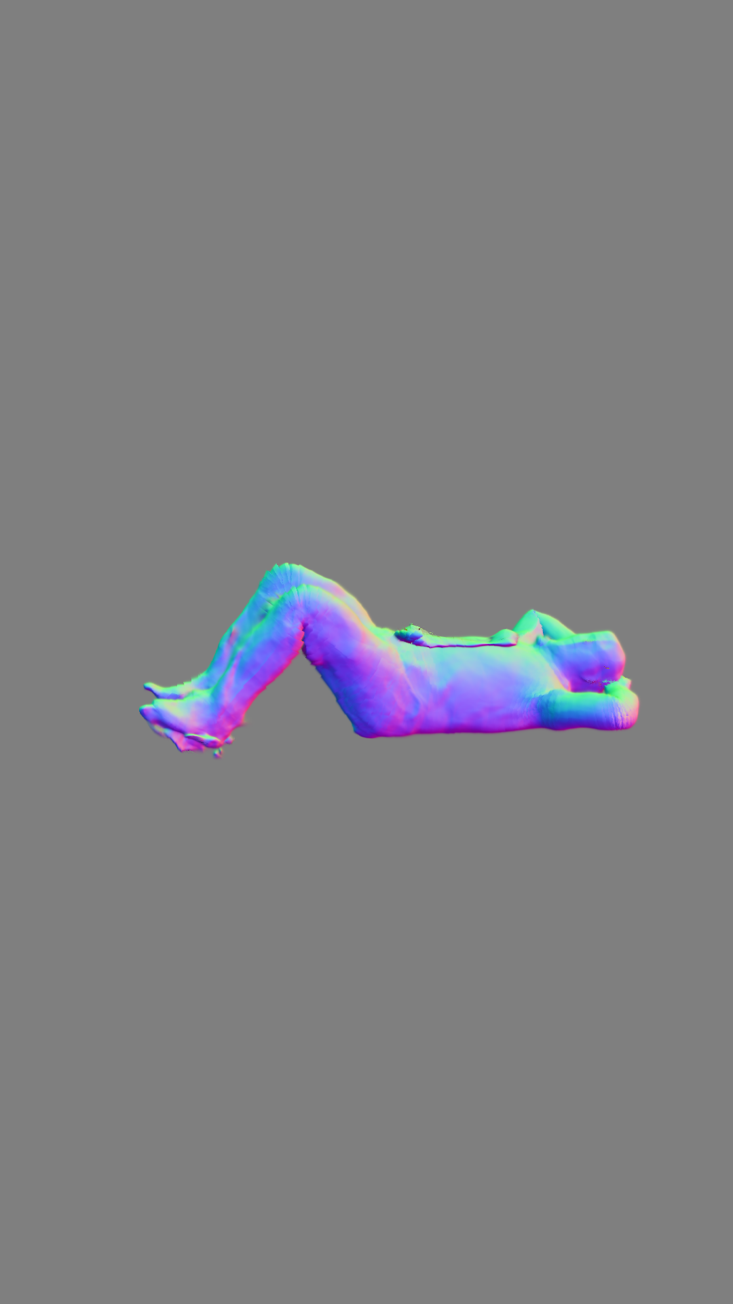
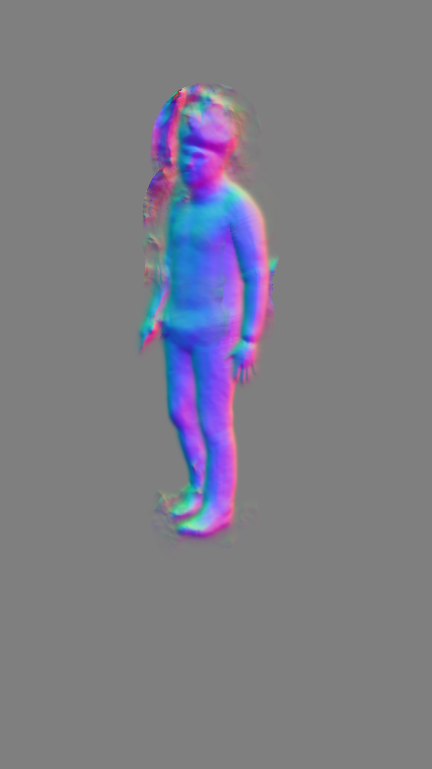
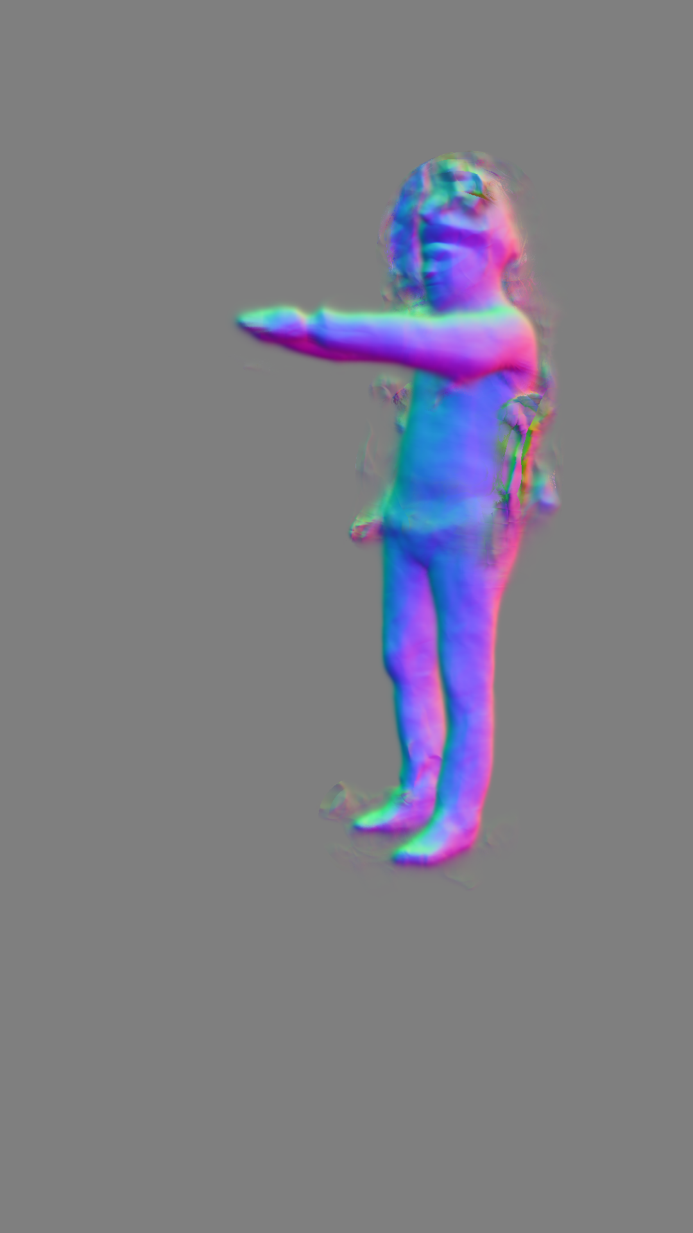
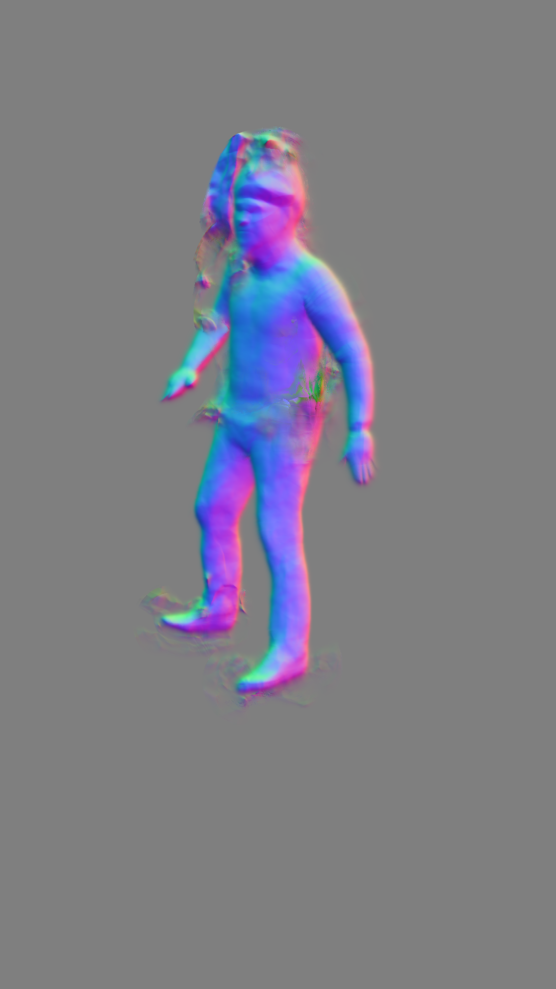
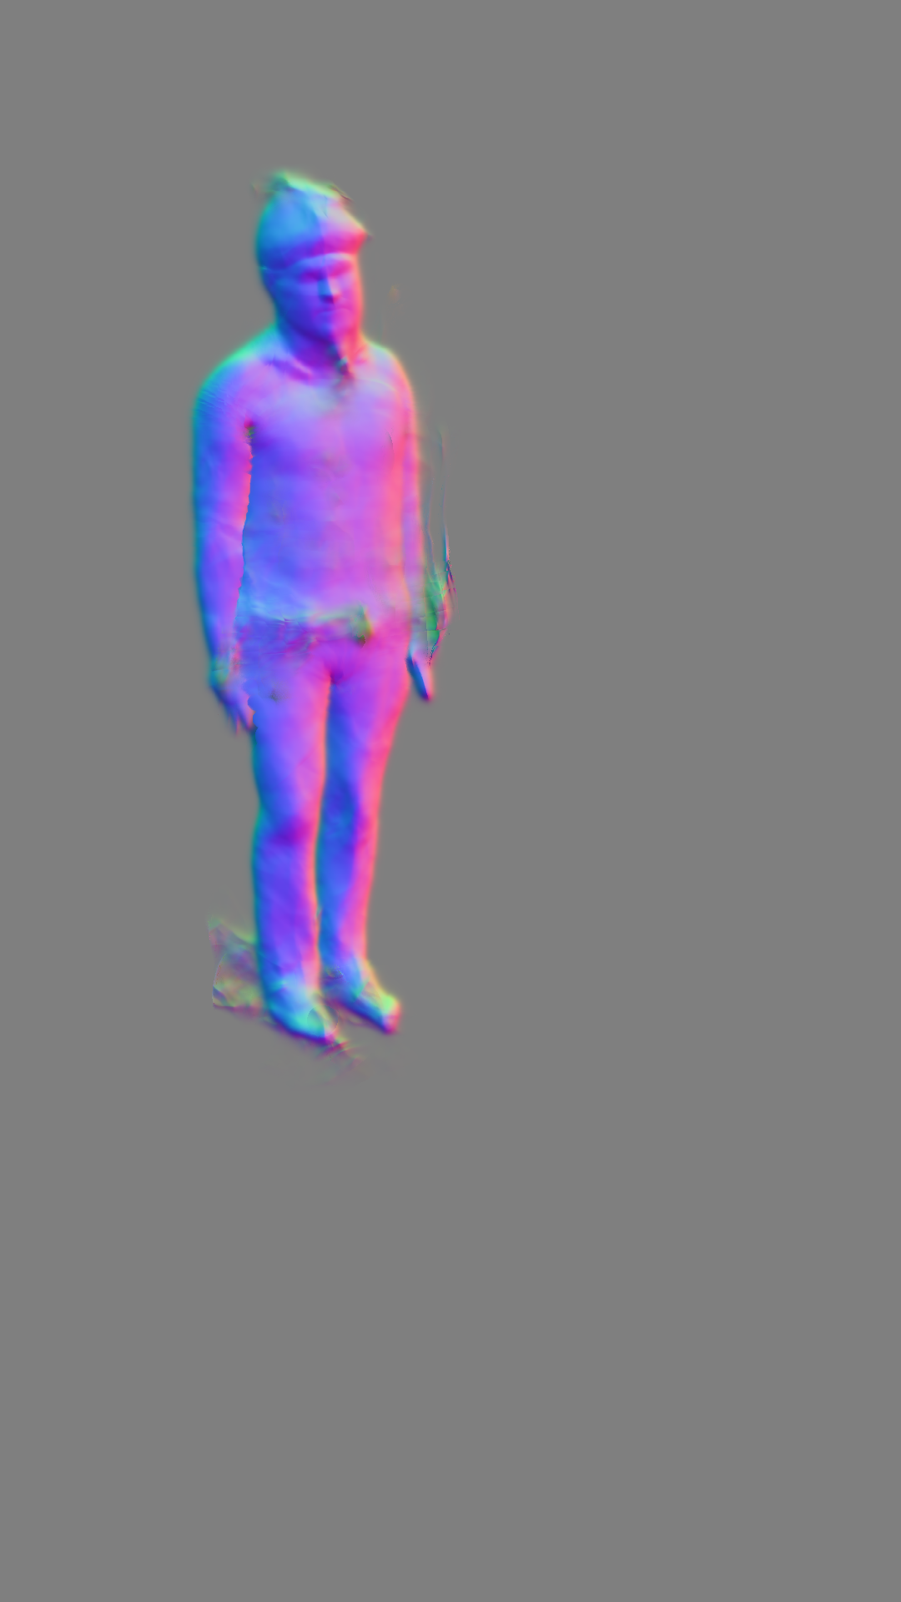
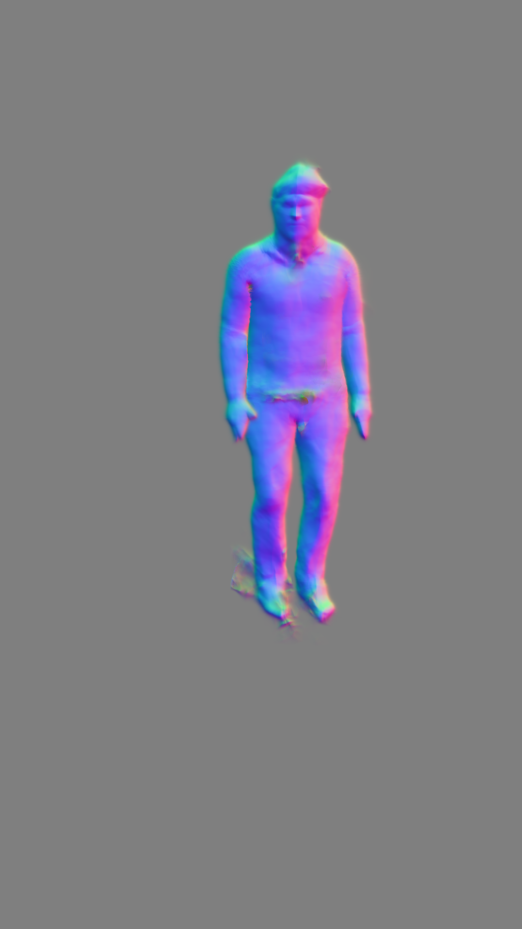
Some qualitative results
Courtyard Relax on Bench 00
8
17
26
34
43
n° epochs
Courtyard Body Scanner Motion 00
3
7
11
15
19
n° epochs

Slide 30
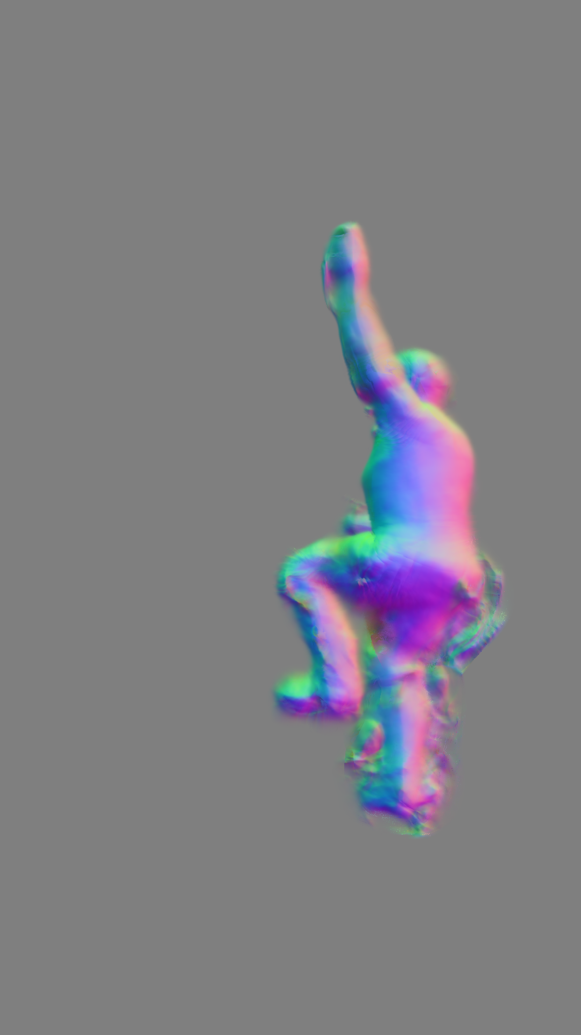
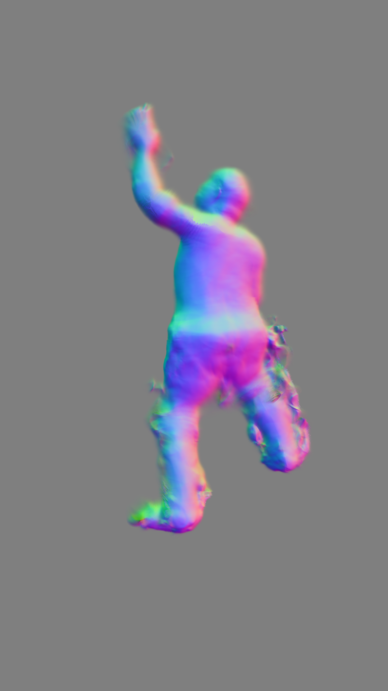
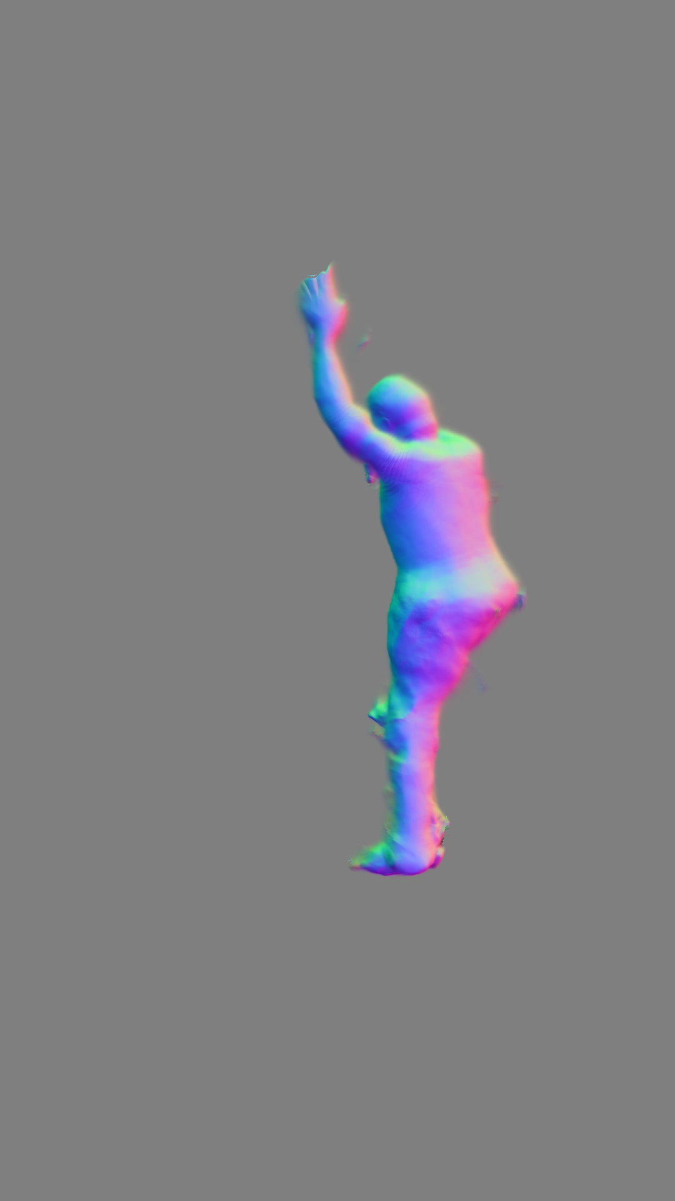
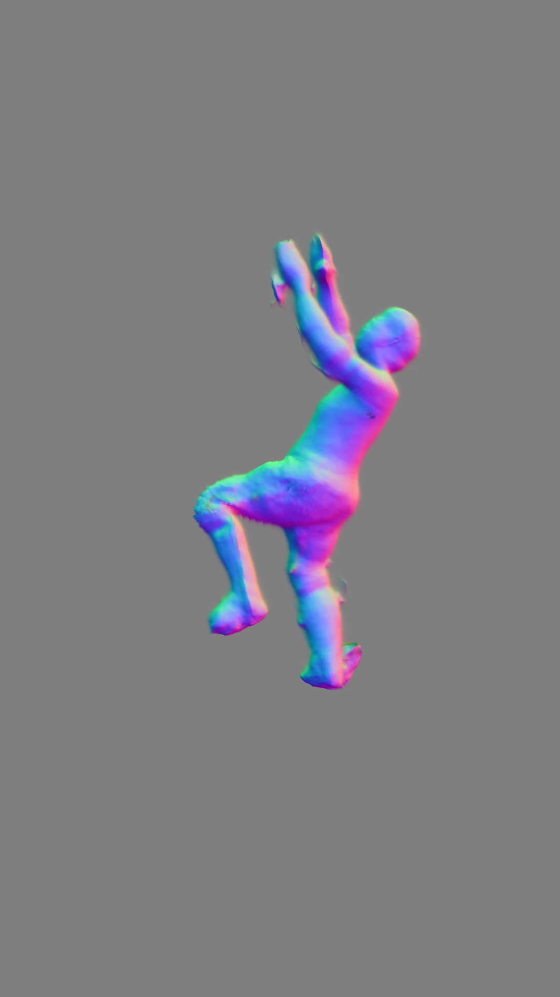
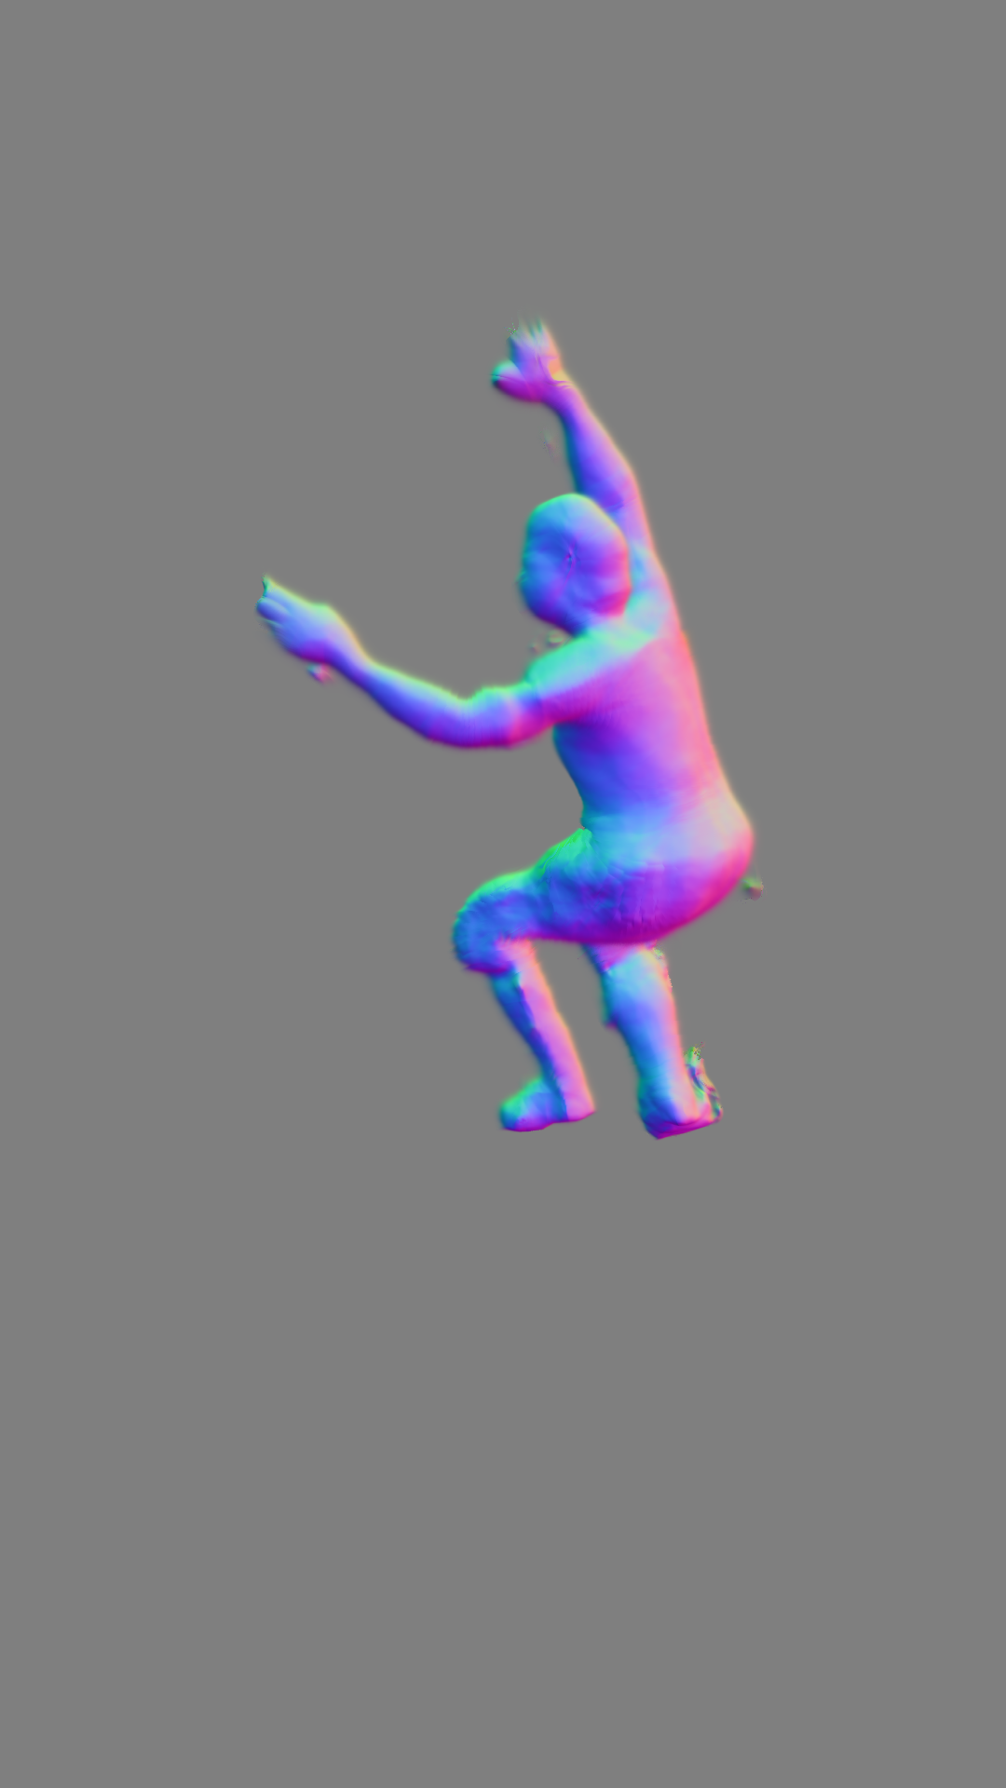
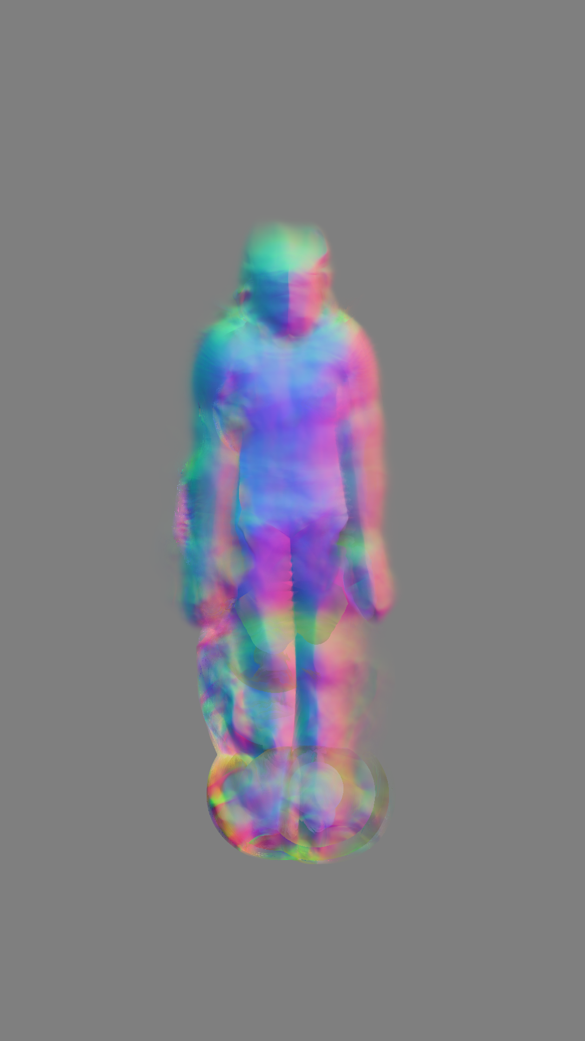
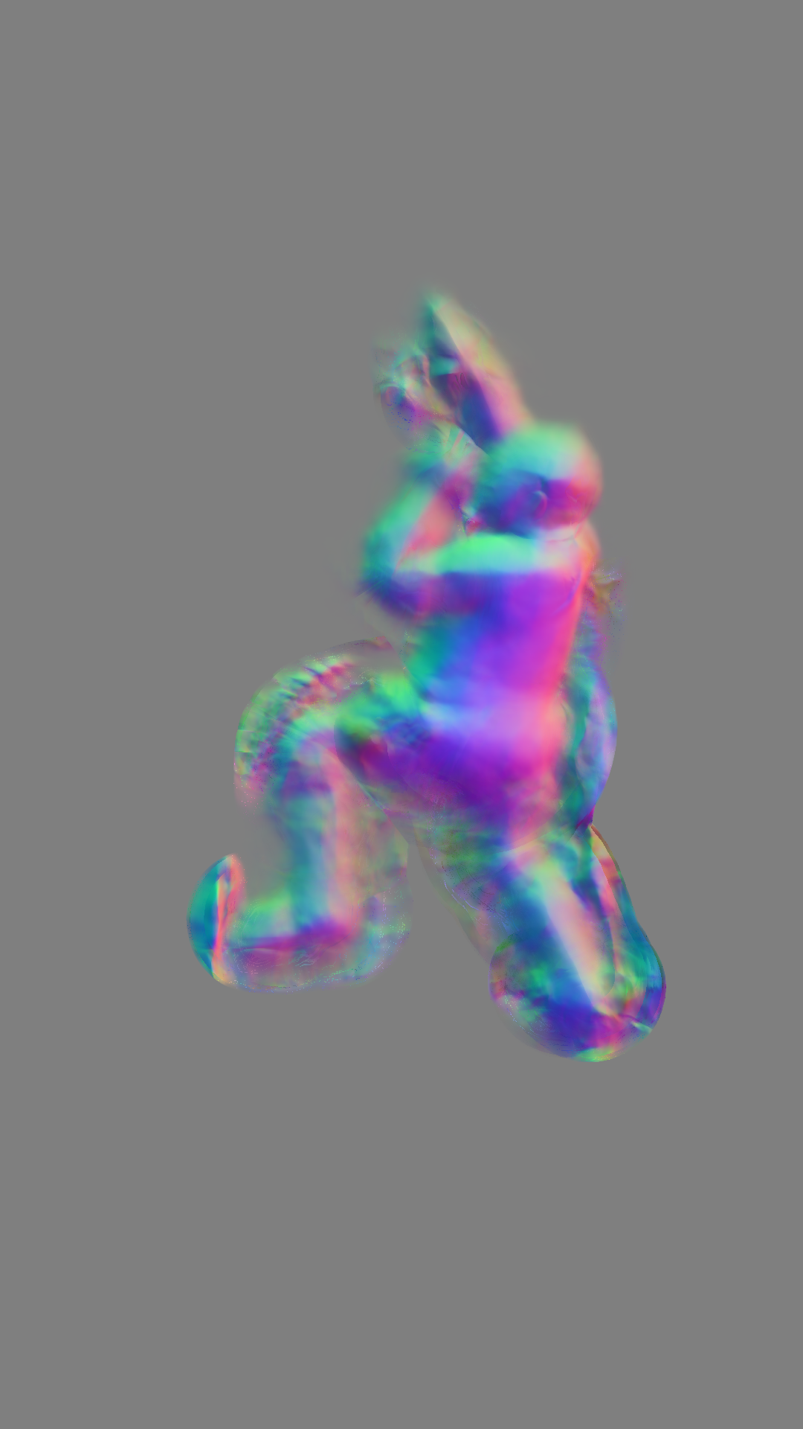
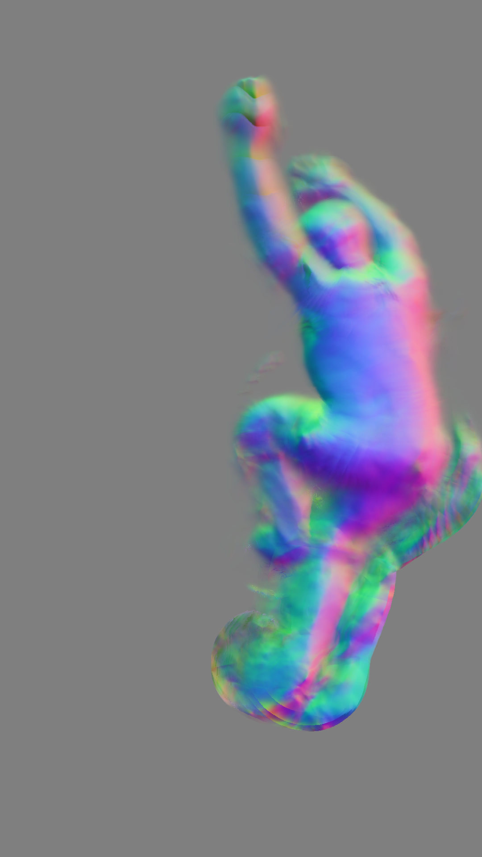
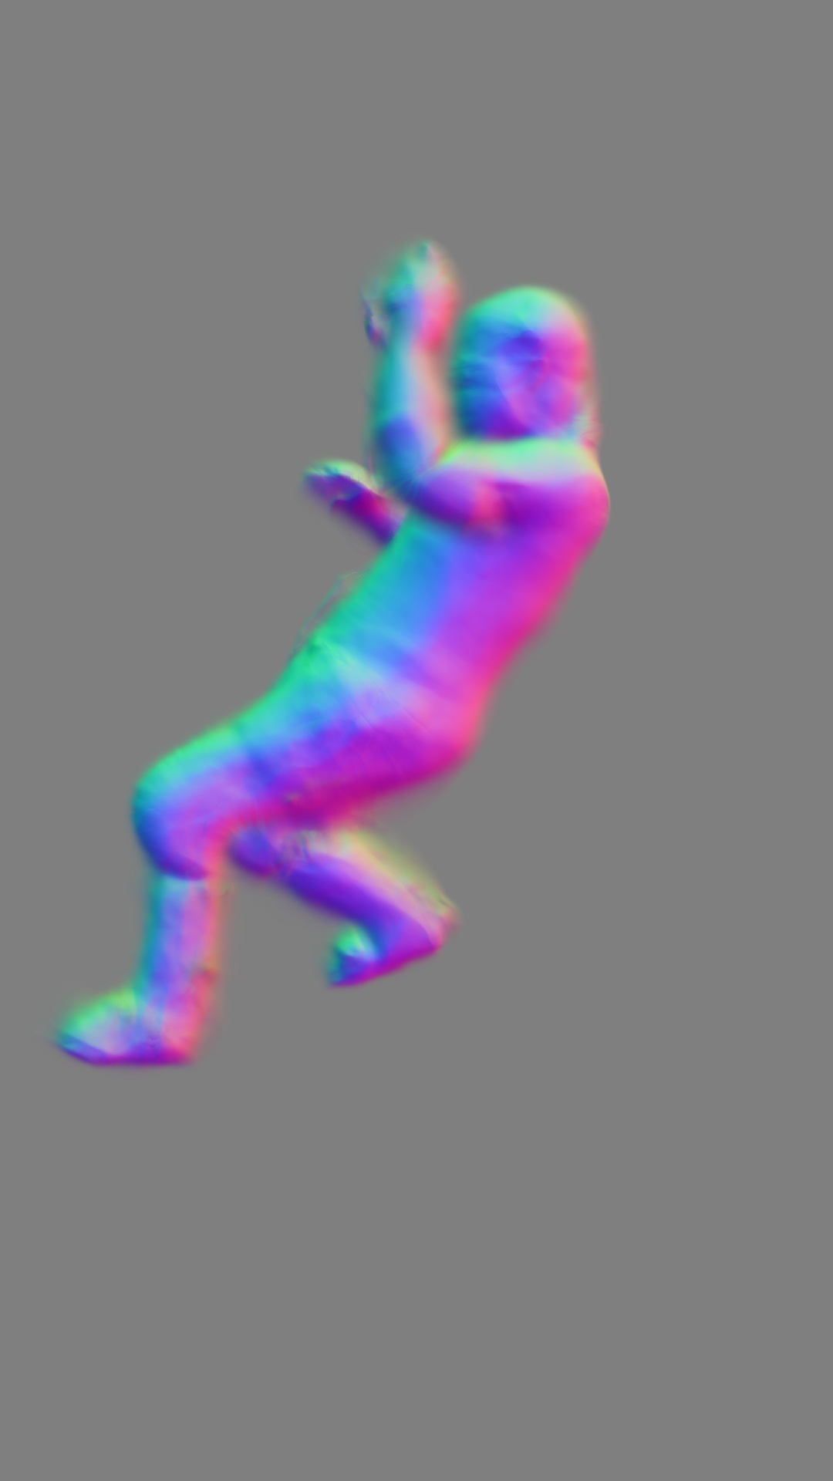
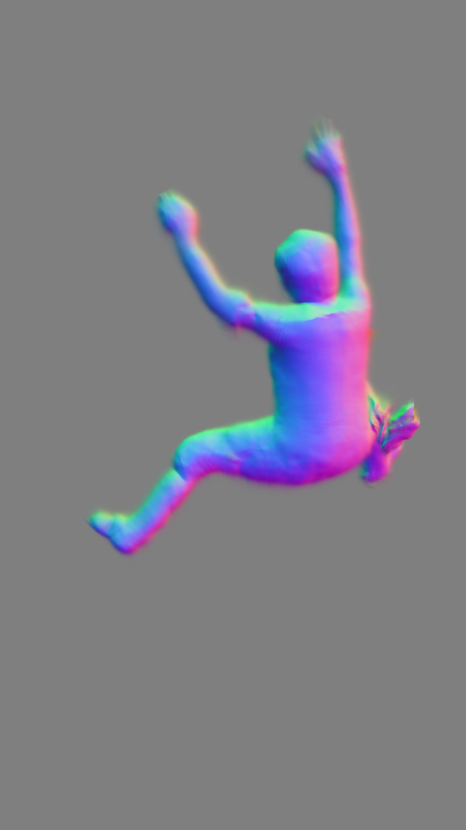
Some qualitative results
Outdoors climbing 00
3
7
11
15
19
n° epochs
Outdoors climbing 01
4
9
14
19
24
n° epochs

Slide 31
Conclusions & Future Directions

Slide 32
Considerations & Future directions
Generalization of the model:
Improving the data: representativeness, consistency
Improving the conditioning: encoding, higher-dimensional projection
Future directions:
Dataset composition
Leveraging the pretrained implicit representation
Code optimization

Slide 33
Conclusions
Contributions:
Reconstruction at inference time
Generalized pretrained implicit representation
Quality of reconstruction on short-time refined inference
Scalable solution needless of 3D annotations

Slide 34
References
[1] Guo, Chen, et al. "Vid2avatar: 3d avatar reconstruction from videos in the wild via self-supervised scene decomposition." Proceedings of the IEEE/CVF Conference on Computer Vision and Pattern Recognition. 2023.
[2] Von Marcard, Timo, et al. "Recovering accurate 3d human pose in the wild using imus and a moving camera." Proceedings of the European conference on computer vision (ECCV). 2018.
[3] Jiang, Wei, et al. "Neuman: Neural human radiance field from a single video." European Conference on Computer Vision. Cham: Springer Nature Switzerland, 2022.

Slide 35
Self-Supervised 3D Reconstruction from Monocular Videos via Implicit Representation
Thank you for your attention

